Slide 1
UNIT NO. – 1 NUMBER SYSTEM
SUBJECT : QALR
Dr.N.Manjula ASSISTANT PROFESSOR OF MATHEMATICS SCIENCE & HUMANITIES SNIST

Slide 2
NUMBERS
In Hindu Arabic system, we have 10 digits namely 0,1,2,3,4,……,9 are called zero, one, two,……..,nine respectively.
A number is denoted by a group of digits is called numeral.
For denoting a numeral, we use the “Place-value Chart:
Face value and place value (local value) of a digit in a numeral:
The face value of a digit in numeral is its own value at whatever place it may be.
Ex: In the numeral 2768, the face values if 8 is 8, 6 is 6, 7 is 7 and 2 is 2.

Slide 3
Place value:
Place value of unit digit = (Unit Digit) × 1
Place value of tens digit = (tens Digit) × 10
Place value of hundreds digit = (Hundreds Digit) × 100 and so on.
Ex: In the numeral 62013, we have
Place value of 3 = (3) × 1 = 3
Place value of 1 = (1) × 10 = 10
Place value of 0 = (0) × 100 = 0
Place value of 2 = (2) × 1000 = 2000
Place value of 6 = (6) × 10k = 60k
NOTE: Place value of zero is zero in a given numeral, at whatever place it may be.

Slide 4
TYPES OF NUMBERS
NATURAL NUMBER:
All counting numbers are called natural numbers.
It is denoted by “N”. i.e. N = ( 1,2,3,4,…….)
WHOLE NUMBERS:
All counting numbers and 0 form whole numbers.
It is denoted by “W”. i.e. W = ( 0,1,2,3,4,…….)
INTEGERS:
All counting numbers and negative counting numbers and 0 form the set of Interger numbers.
It is denoted by “Z”. i.e. Z = ( ………..-4,-3,-2,-1,0,1,2,3,4,…….)

Slide 5
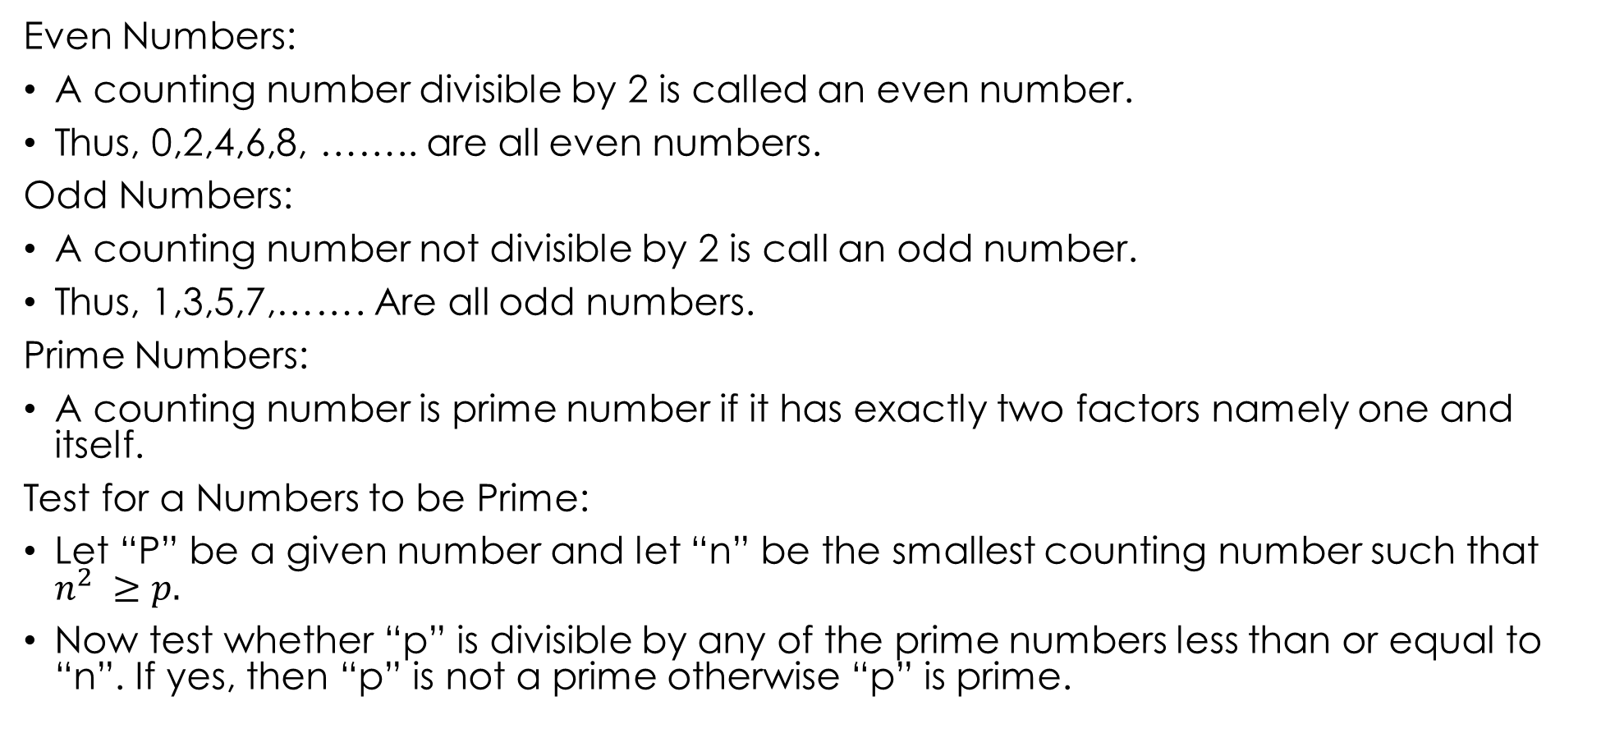
EVEN AND ODD NUMBERS
Even Numbers:
A counting number divisible by 2 is called an even number.
Thus, 0,2,4,6,8, …….. are all even numbers.
Odd Numbers:
A counting number not divisible by 2 is call an odd number.
Thus, 1,3,5,7,……. Are all odd numbers.
Prime Numbers:
A counting number is prime number if it has exactly two factors namely one and itself.
Test for a Numbers to be Prime:
Let “P” be a given number and let “n” be the smallest counting number such that $n^{2} ≥p.$
Now test whether “p” is divisible by any of the prime numbers less than or equal to “n”. If yes, then “p” is not a prime otherwise “p” is prime.

Slide 6
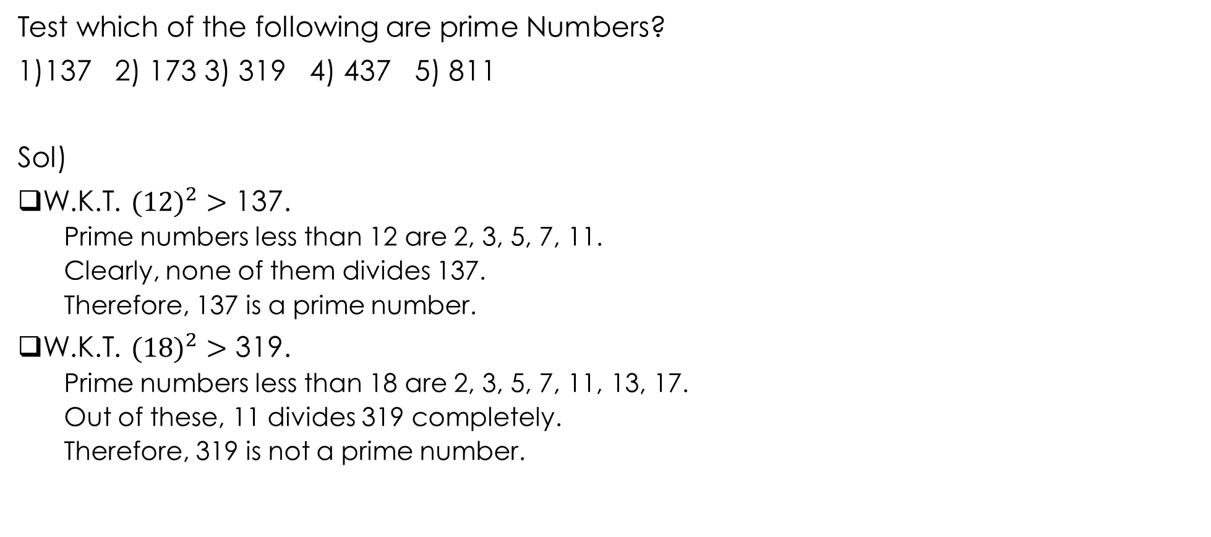
Problems
Test which of the following are prime Numbers?
1)137 2) 173 3) 319 4) 437 5) 811
Sol)
W.K.T. $({12)}^{2}>$ 137.
Prime numbers less than 12 are 2, 3, 5, 7, 11.
Clearly, none of them divides 137.
Therefore, 137 is a prime number.
W.K.T. $({18)}^{2}>$ 319.
Prime numbers less than 18 are 2, 3, 5, 7, 11, 13, 17.
Out of these, 11 divides 319 completely.
Therefore, 319 is not a prime number.

Slide 7
COMPOSITE NUMBERS:
The natural numbers which are not prime is called composite numbers.
CO PRIMES:
Two natural numbers a and b are said to be co primes if their HCF is 1.
Ex: (2,3), (4,5), (7,9), (11,8). Etc…..

Slide 8
TEST OF DIVISIBILITY
Divisibility by 2:
A number is divisible by 2 if its units digits is any of 0,2,4,6,8.
Ex: 68264 is divisible by 2, while 68265 is not divisible by 2.
2) Divisibility by 3 :
A number is divisible by 3 only when the sum of digits is divisible by 3.
Ex: In 695421, sum of digits= 27, which is divisible by 3.
3) Divisibility by 9 :
A number is divisible by 9 only when the sum of its digits is divisible by 9.

Slide 9
4) Divisibility by 4 :
A number is divisible by 4 if the numbers formed by its last two digits is divisible by 4.
Ex:
6879376 ------- 76 ÷ 4 => given numbers divisible by 4.
496138 -------- 38 ÷ 4 => given number is not divisible by 4.
5) Divisibility by 8 :
A number is divisible by 8 if the numbers formed by hundreds, tens and units digit of the given number is divisible by 8.
Ex:
16789352 --------- 352 ÷ 8 => given numbers divisible by 8.
576484 -------- 484 ÷ 8 => given number is not divisible by 8.
6) Divisibility by 10 :
A number is divisible by 10 only when its units digits is zero.
Ex:
123450 => given numbers divisible by 10.
123455 => given number is not divisible by 10.

Slide 10
7) Divisibility by 5:
A number is divisible by 5 only when its units digits is “0” or “5”.
Ex:
76895 => given number is divisible by 5.
68790 => given number is divisible by 5.
8) Divisibility by 11 :
A number is divisible by 11 if the difference between the sum of its digits at odd places and the sum its digits at even places is either 0 or a number divisible by 11.
Ex:
29435417 = (7+4+3+9) – (1+5+4+2) = 11
Therefore, given number is divisible by 11.
b.57463822 : similarly, (23-14) = 9
Therefore, given number is not divisible by 11.

Slide 11
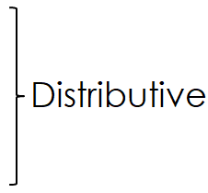

PROBLEMS
1) 5793405 × 9999 =?
Sol: 5793405 × (10000 – 1) = ……
2) 976 × 237 ± 976 × 763 =?
Sol: 976 (237 ± 763) = …….
3) 1607 × 1607
Sol: ${(1607)}^{2}= {(1600+7)}^{2}= {(a+b)}^{2}=…$
4) (475 × 475 + 125 × 125) =?
Sol: ${(a}^{2}+b^{2})={}_{2}^{1}{[{(a+b)}^{2}}+{(a−b)}^{2}]=…$
5) (796 × 796) – (204 × 204) =?
Sol: ${(a}^{2}−b^{2})=(a+b)(a−b)=…$

Slide 12
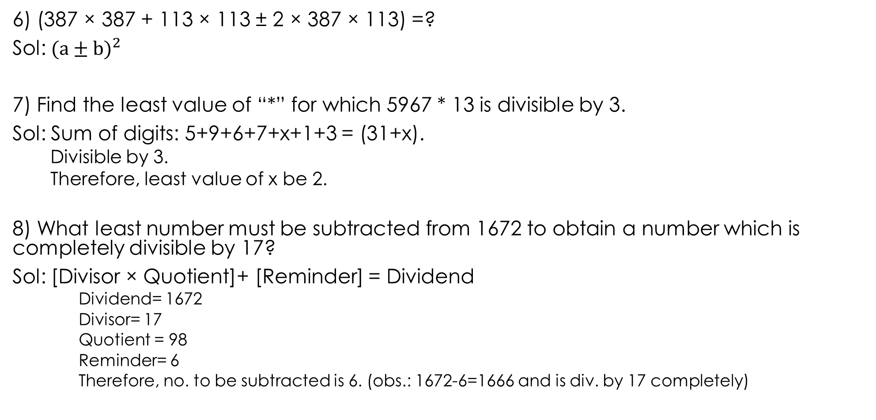
6) (387 × 387 + 113 × 113 ± 2 × 387 × 113) =?
Sol: ${(a±b)}^{2}$
7) Find the least value of “*” for which 5967 * 13 is divisible by 3.
Sol: Sum of digits: 5+9+6+7+x+1+3 = (31+x).
Divisible by 3.
Therefore, least value of x be 2.
8) What least number must be subtracted from 1672 to obtain a number which is completely divisible by 17?
Sol: [Divisor × Quotient]+ [Reminder] = Dividend
Dividend= 1672
Divisor= 17
Quotient = 98
Reminder= 6
Therefore, no. to be subtracted is 6. (obs.: 1672-6=1666 and is div. by 17 completely)

Slide 13
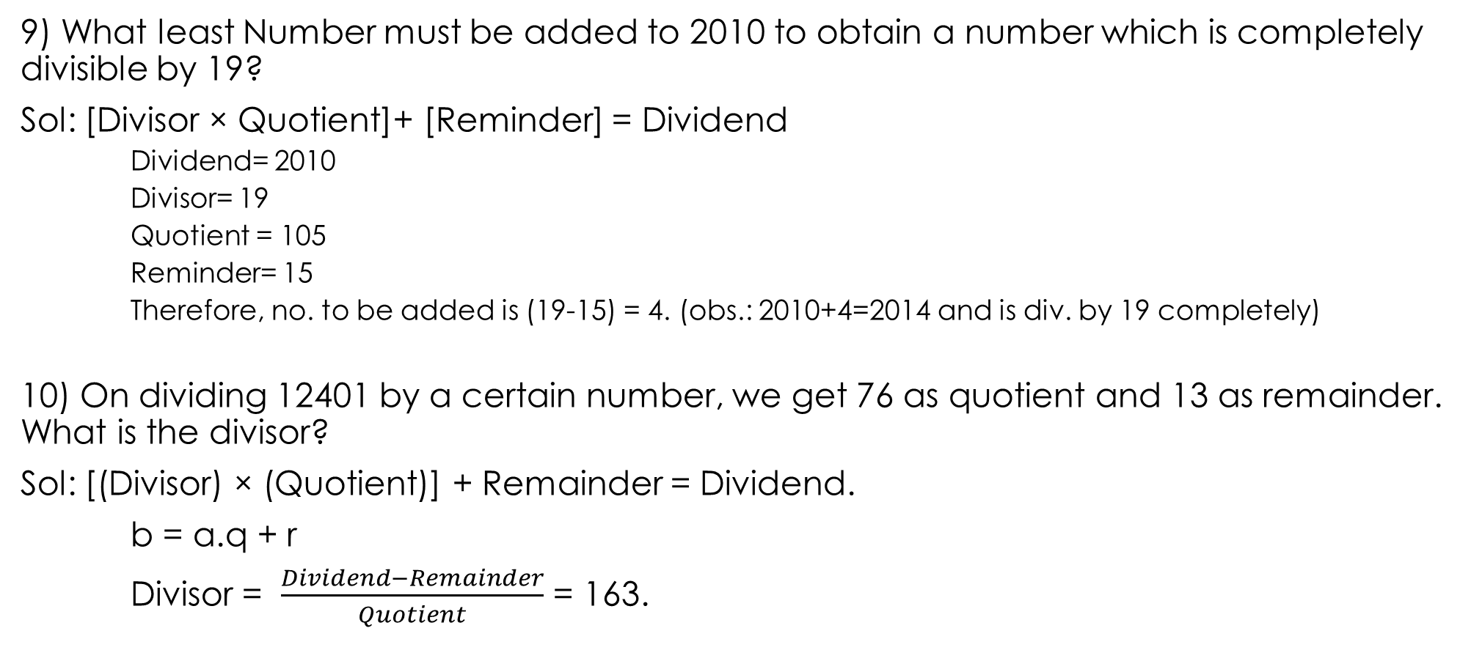
9) What least Number must be added to 2010 to obtain a number which is completely divisible by 19?
Sol: [Divisor × Quotient]+ [Reminder] = Dividend
Dividend= 2010
Divisor= 19
Quotient = 105
Reminder= 15
Therefore, no. to be added is (19-15) = 4. (obs.: 2010+4=2014 and is div. by 19 completely)
10) On dividing 12401 by a certain number, we get 76 as quotient and 13 as remainder. What is the divisor?
Sol: [(Divisor) × (Quotient)] + Remainder = Dividend.
b = a.q + r
Divisor = $\frac{Dividend−Remainder}{Quotient}$ = 163.

Slide 14
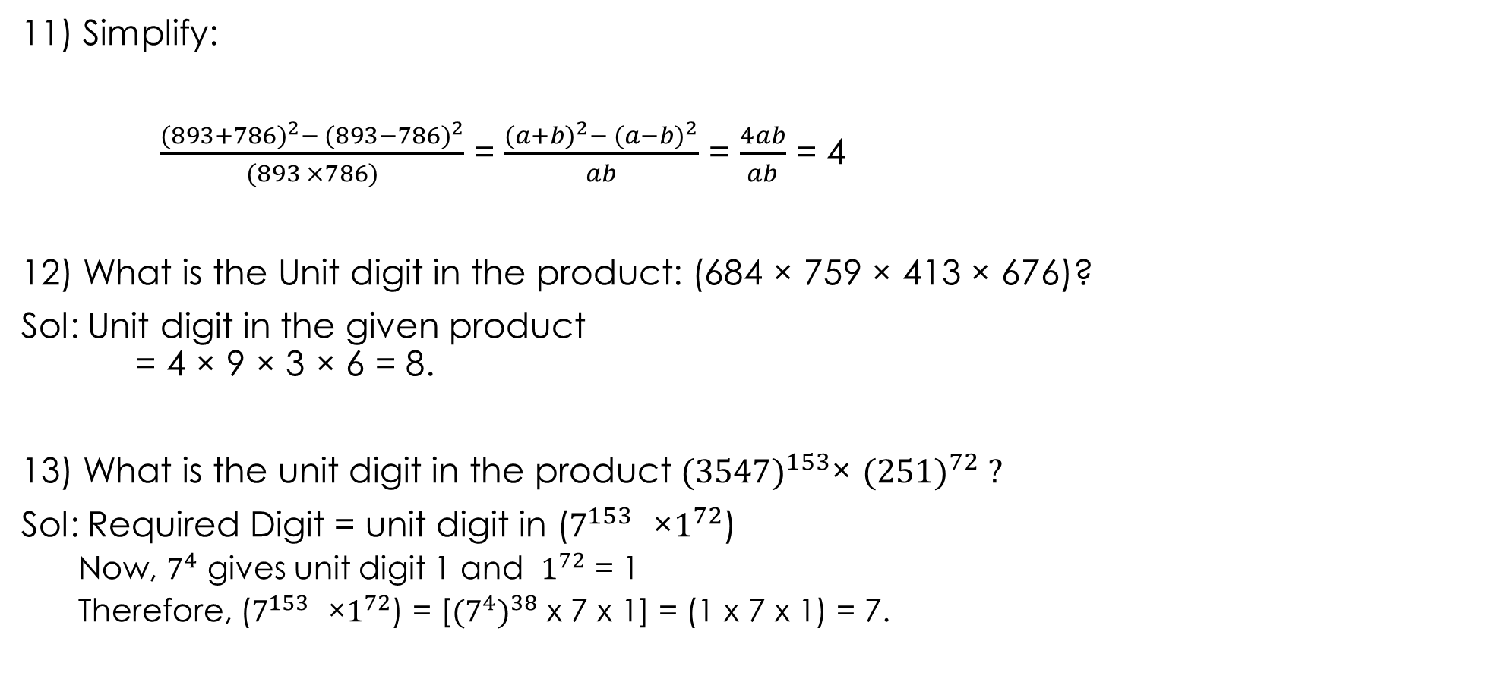
11) Simplify:
$\frac{{(893+786)}^{2}− {(893−786)}^{2}}{(893 ×786)}$ = $\frac{{(a+b)}^{2}− {(a−b)}^{2}}{ab}$ = $\frac{4ab}{ab}$ = 4
12) What is the Unit digit in the product: (684 × 759 × 413 × 676)?
Sol: Unit digit in the given product = 4 × 9 × 3 × 6 = 8.
13) What is the unit digit in the product ${(3547)}^{153}$× ${(251)}^{72} ?$
Sol: Required Digit = unit digit in ($7^{153}$ ×$1^{72}$)
Now, $7^{4}$ gives unit digit 1 and $1^{72}$ = 1
Therefore, ($7^{153}$ ×$1^{72}$) = [${(7^{4})}^{38}$ x 7 x 1] = (1 x 7 x 1) = 7.

Slide 15
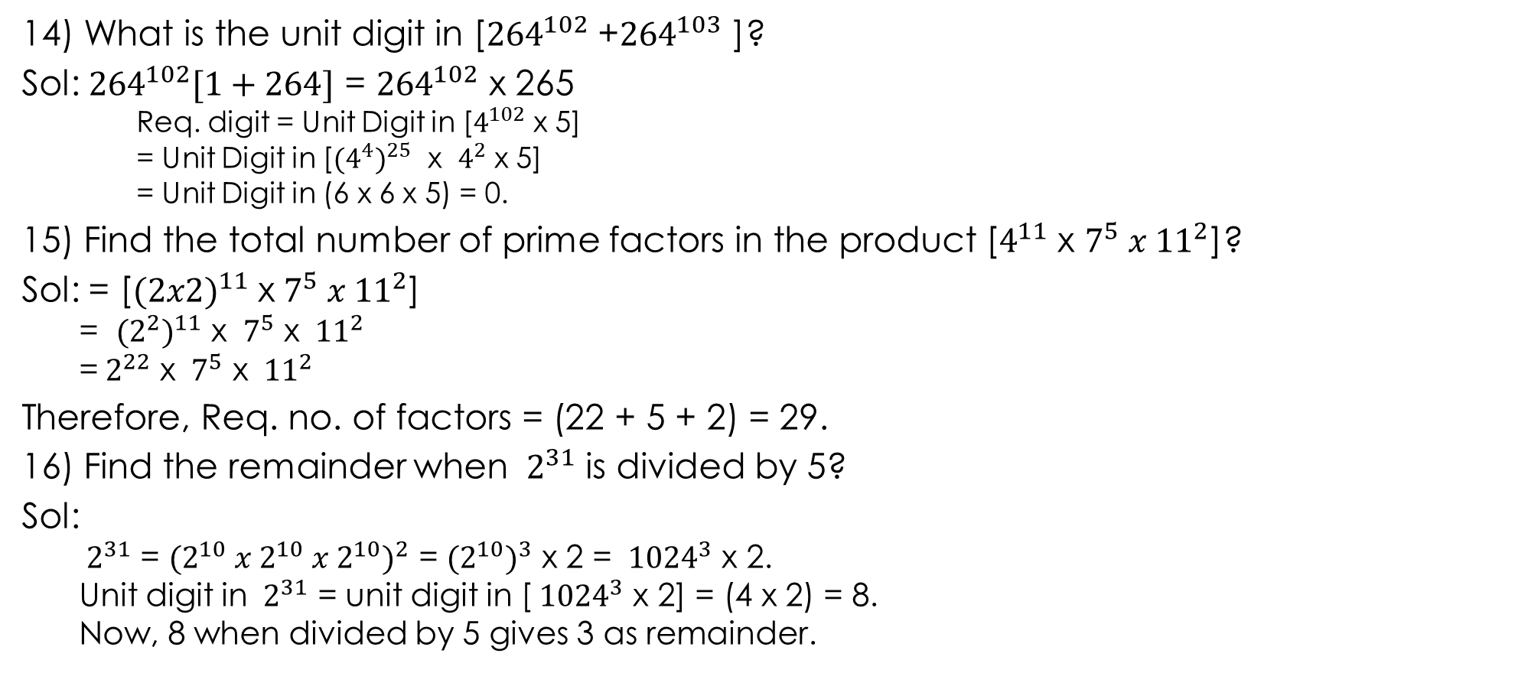
14) What is the unit digit in [${264}^{102}$ +${264}^{103}$ ]?
Sol: ${264}^{102}[1+264]$ = ${264}^{102}$ x 265
Req. digit = Unit Digit in [$4^{102}$ x 5]
= Unit Digit in [${(4^{4})}^{25}$ x $4^{2}$ x 5]
= Unit Digit in (6 x 6 x 5) = 0.
15) Find the total number of prime factors in the product [$4^{11}$ x $7^{5} x {11}^{2}$]?
Sol: = [${(2x2)}^{11}$ x${ 7}^{5} x {11}^{2}$]
= ${(2^{2})}^{11}$ x ${ 7}^{5}$ x ${ 11}^{2}$
=${ 2}^{22}$ x ${ 7}^{5}$ x ${ 11}^{2}$
Therefore, Req. no. of factors = (22 + 5 + 2) = 29.
16) Find the remainder when ${ 2}^{31}$ is divided by 5?
Sol:
${ 2}^{31}$ = ${(2^{10} x{ 2}^{10} x 2^{10})}^{2}$ = ${(2^{10})}^{3}$ x 2 = ${ 1024}^{3}$ x 2.
Unit digit in ${ 2}^{31}$ = unit digit in [${ 1024}^{3}$ x 2] = (4 x 2) = 8.
Now, 8 when divided by 5 gives 3 as remainder.

Slide 16

FORMULAE
1 + 2 + 3 + …….+ n = $\frac{1}{2}[n(n+1)]$ = $\frac{n(n+1)}{2}$.
$1^{2}+ 2^{2}+ 3^{2}+………………. + n^{2}$ = $\frac{n(n+1)(2n+1) }{6}$.
$1^{3}+ 2^{3}+ 3^{3}+………………. + n^{3}$ = $\frac{n^{2}({n+1)}^{2}}{4}$.

Slide 17
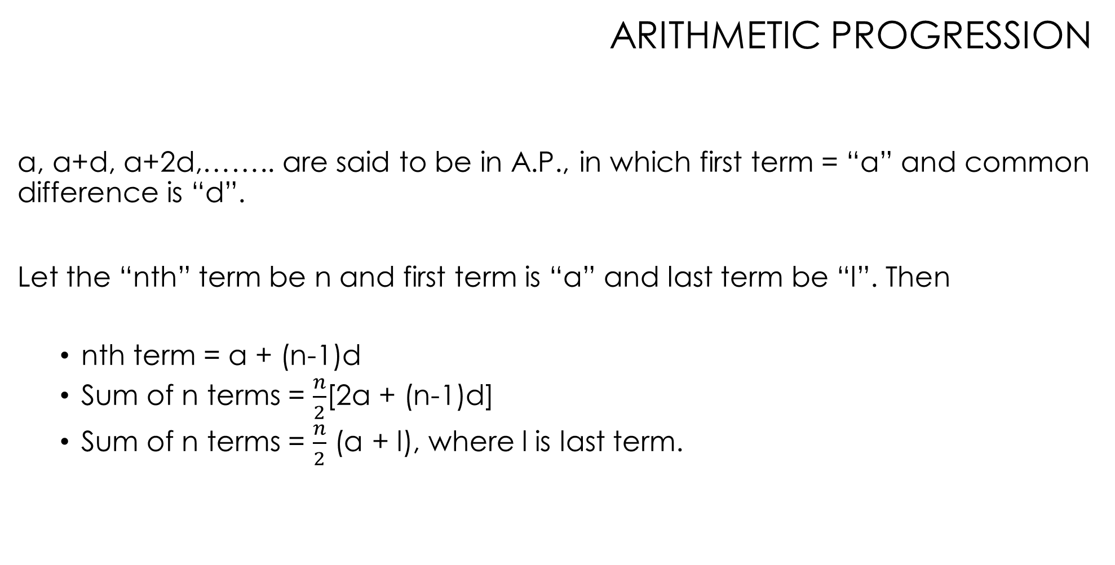
ARITHMETIC PROGRESSION
a, a+d, a+2d,…….. are said to be in A.P., in which first term = “a” and common difference is “d”.
Let the “nth” term be n and first term is “a” and last term be “l”. Then
nth term = a + (n-1)d
Sum of n terms = $\frac{n}{2}$[2a + (n-1)d]
Sum of n terms = $\frac{n}{2}$ (a + l), where l is last term.

Slide 18

GEOMETIC PROGRESSION
$a$, $ar$, ${ar}^{2}, {ar}^{3},$……… are said to be in G.P., in which first term = “$a$” and the common ratio = “r”.
nth term = ${ar}^{n−1}$
Sum of n terms
$\frac{a(1−r^{n})}{1−r}$, where r <1
$\frac{a(r^{n }−1)}{r−1}$, where r > 1

Slide 19
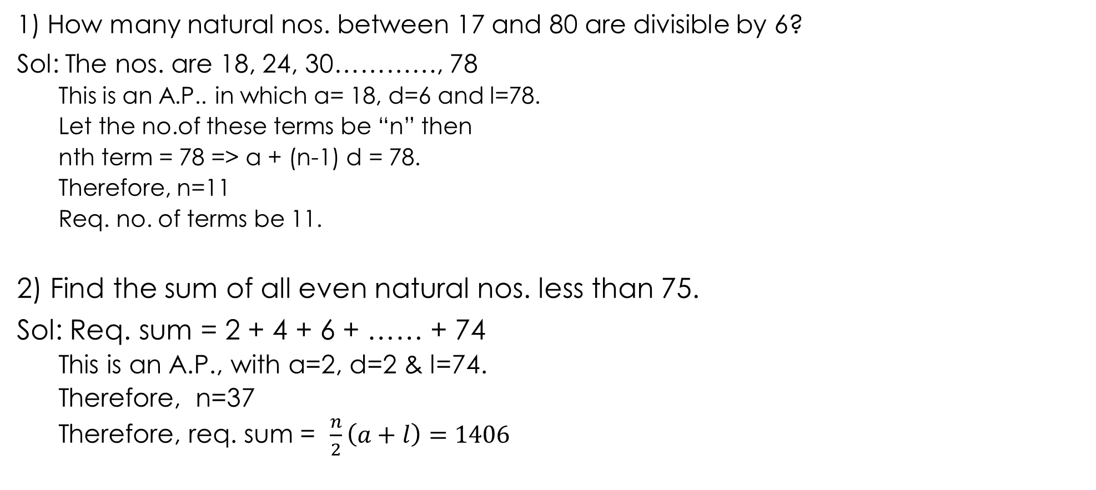
PROBLEMS
1) How many natural nos. between 17 and 80 are divisible by 6?
Sol: The nos. are 18, 24, 30…………, 78
This is an A.P.. in which a= 18, d=6 and l=78.
Let the no.of these terms be “n” then
nth term = 78 => a + (n-1) d = 78.
Therefore, n=11
Req. no. of terms be 11.
2) Find the sum of all even natural nos. less than 75.
Sol: Req. sum = 2 + 4 + 6 + …… + 74
This is an A.P., with a=2, d=2 & l=74.
Therefore, n=37
Therefore, req. sum = $\frac{n}{2}\left(a+l\right)=1406$

Slide 20
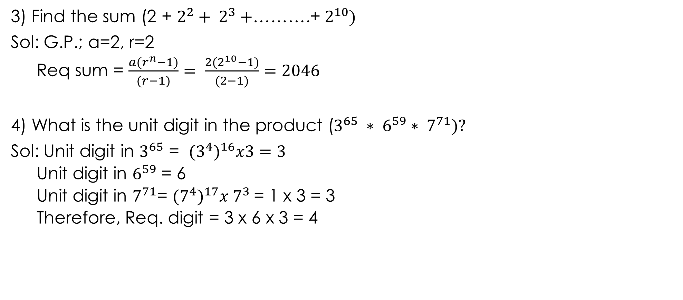
3) Find the sum (2 + $2^{2}­+ 2^{3}+$……….+ $2^{10})$
Sol: G.P.; a=2, r=2
Req sum = $\frac{a(r^{n}−1)}{(r−1)}= \frac{2(2^{10}−1)}{(2−1)}=2046$
4) What is the unit digit in the product ($3^{65} ∗ 6^{59}∗ 7^{71})?$
Sol: Unit digit in $3^{65}$ = ${(3^{4})}^{16}x3=3$
Unit digit in $6^{59}$ = 6
Unit digit in $7^{71}$= ${(7^{4})}^{17}x 7^{3}$= 1 x 3 = 3
Therefore, Req. digit = 3 x 6 x 3 = 4

Slide 21
6) Which one of the following numbers is completely divisible by 45?
181560 b. 331145 c. 202860 d. 203550 e. None
Sol: 45= 5 x9, 5,9 are co-primes
So, div. by 5 and div. by 9 should be applicable.
7) If the number 42573* is exactly divisible by 72, then the minimum value of * is______
Sol: 72 = 8 x 9, where 8,9 are co-primes (so both the concepts will apply)
So, the given no. is divisible by 8 only when the minimum no. of * be 6.
Sum of digits of 425736 = 27, which is divided by 9.
Therefore, req. no = 6.

Slide 22
9) If the product 4864*9p2 is divisible by 12, the minimum value of “p” is_____
Sol: 12 = 4x3, clearly 4864 is divisible by 4.
So 9p2 must be divisible by 3
i.e., 9 + p +2 = 11+p = 11+1=12
Therefore, P=1.

Slide 23
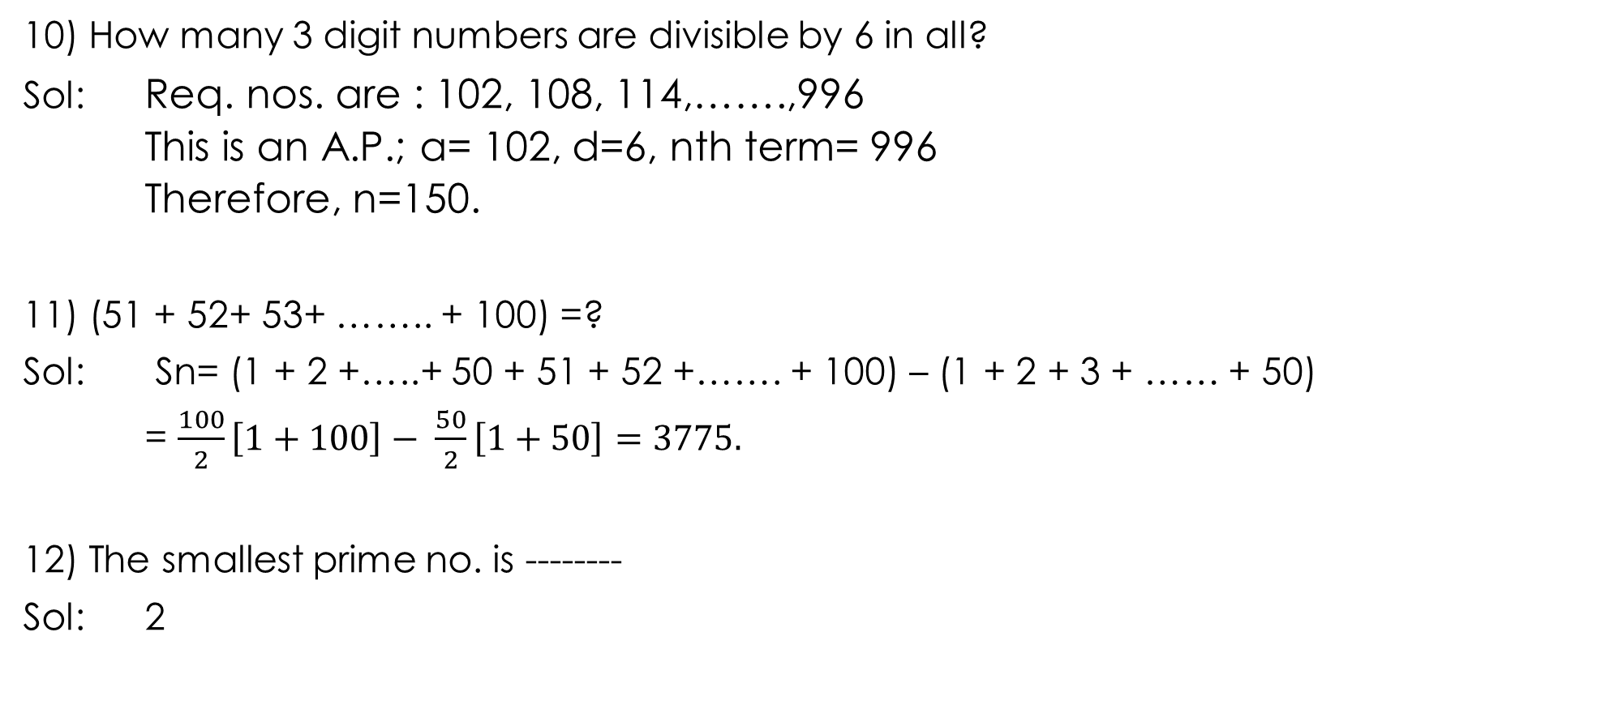
10) How many 3 digit numbers are divisible by 6 in all?
Sol: Req. nos. are : 102, 108, 114,…….,996
This is an A.P.; a= 102, d=6, nth term= 996
Therefore, n=150.
11) (51 + 52+ 53+ …….. + 100) =?
Sol: Sn= (1 + 2 +…..+ 50 + 51 + 52 +……. + 100) – (1 + 2 + 3 + …… + 50)
= $\frac{100}{2}\left[1+100\right]− \frac{50}{2}\left[1+50\right]=3775.$
12) The smallest prime no. is --------
Sol: 2

Slide 24
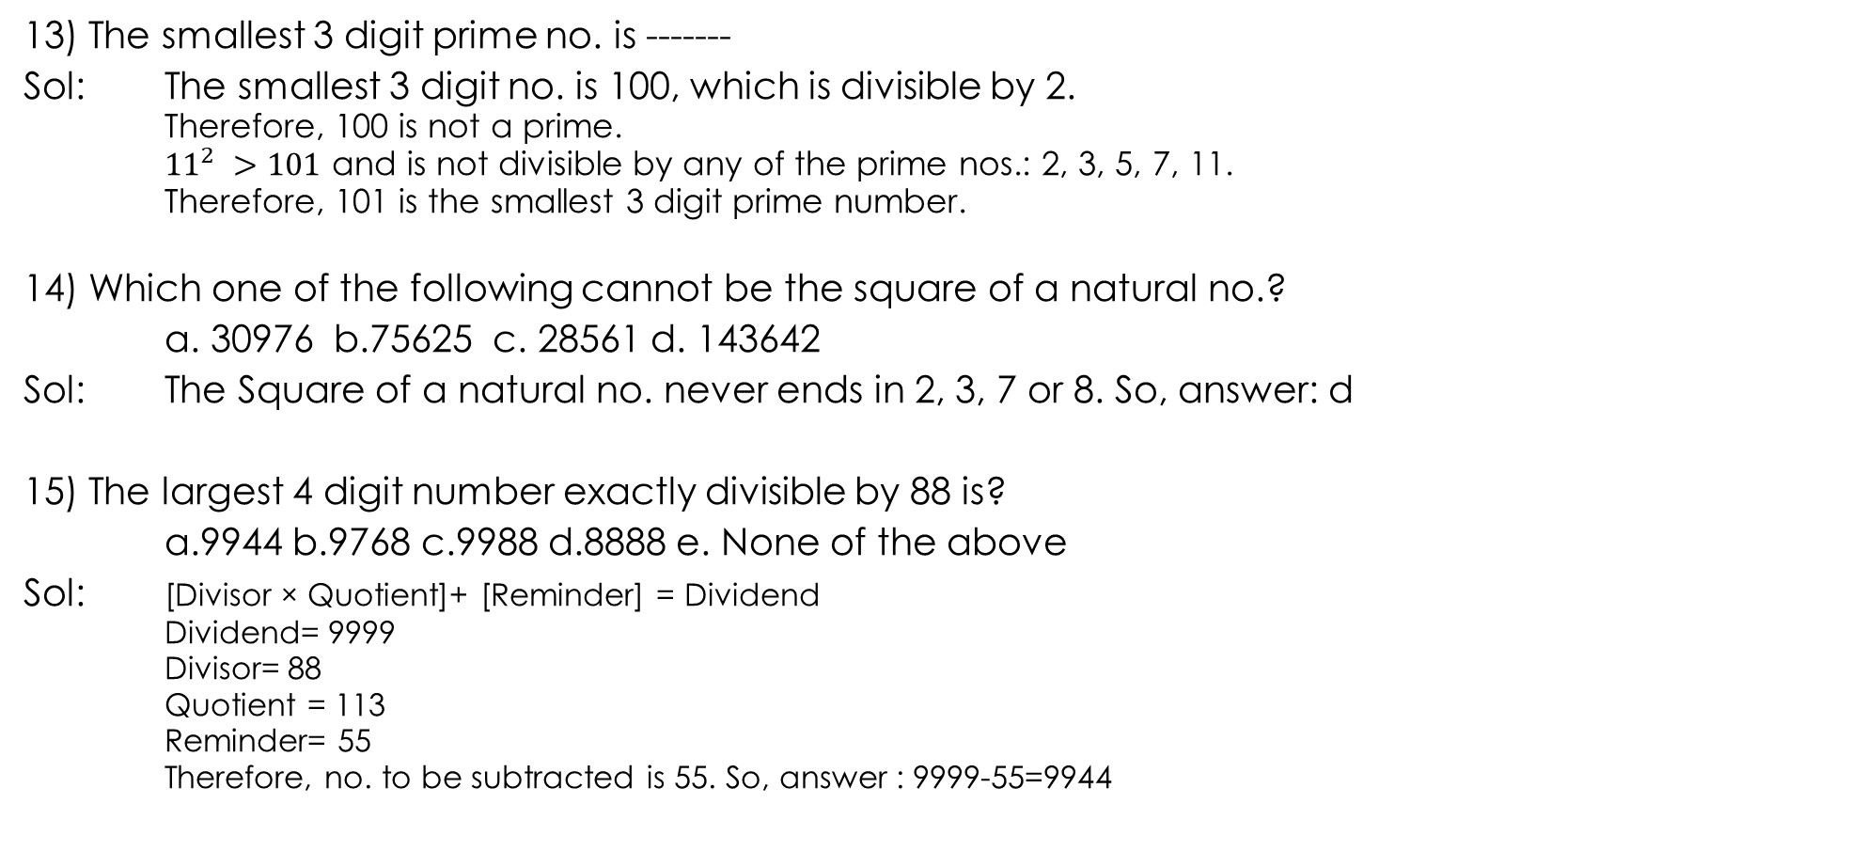
13) The smallest 3 digit prime no. is -------
Sol: The smallest 3 digit no. is 100, which is divisible by 2.
Therefore, 100 is not a prime.
${11}^{2} >101$ and is not divisible by any of the prime nos.: 2, 3, 5, 7, 11.
Therefore, 101 is the smallest 3 digit prime number.
14) Which one of the following cannot be the square of a natural no.?
a. 30976 b.75625 c. 28561 d. 143642
Sol: The Square of a natural no. never ends in 2, 3, 7 or 8. So, answer: d
15) The largest 4 digit number exactly divisible by 88 is?
a.9944 b.9768 c.9988 d.8888 e. None of the above
Sol: [Divisor × Quotient]+ [Reminder] = Dividend
Dividend= 9999
Divisor= 88
Quotient = 113
Reminder= 55
Therefore, no. to be subtracted is 55. So, answer : 9999-55=9944

Slide 25
16) What least no must be subtracted from 13601, so that the remainder is divisible by 87?
a. 29 b.31 c.29 d.37 e.49
Sol: [Divisor × Quotient]+ [Reminder] = Dividend
Dividend= 13601
Divisor= 87
Quotient = 156
Reminder= 29
Therefore, no. to be subtracted is 29. (obs.: 13601-29=13572)
17) On dividing a number by 56, we get 29 as remainder. On dividing the same no. by 8, what will be the remainder?
Sol) Let “X” be the number and “y” be the quotient. Then,
X= 56*y + 29 = (8 x 7y) + (8 x 3) + 5 = 8 x [7y+3] + 5
Therefore, req. no. = 5 = req. remainder. (D=aq+r)

Slide 26
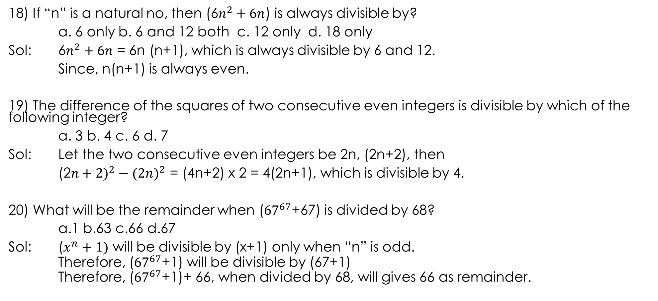
18) If “n” is a natural no, then (6$n^{2}+6n$) is always divisible by?
a. 6 only b. 6 and 12 both c. 12 only d. 18 only
Sol: 6$n^{2}+6n$ = 6n (n+1), which is always divisible by 6 and 12.
Since, n(n+1) is always even.
19) The difference of the squares of two consecutive even integers is divisible by which of the following integer?
a. 3 b. 4 c. 6 d. 7
Sol: Let the two consecutive even integers be 2n, (2n+2), then
(2${n+2)}^{2}−(2{n)}^{2}$ = (4n+2) x 2 = 4(2n+1), which is divisible by 4.
20) What will be the remainder when (${67}^{67}$+67) is divided by 68?
a.1 b.63 c.66 d.67
Sol: ($x^{n}+1)$ will be divisible by (x+1) only when “n” is odd.
Therefore, (${67}^{67}$+1) will be divisible by (67+1)
Therefore, (${67}^{67}$+1)+ 66, when divided by 68, will gives 66 as remainder.

Slide 27
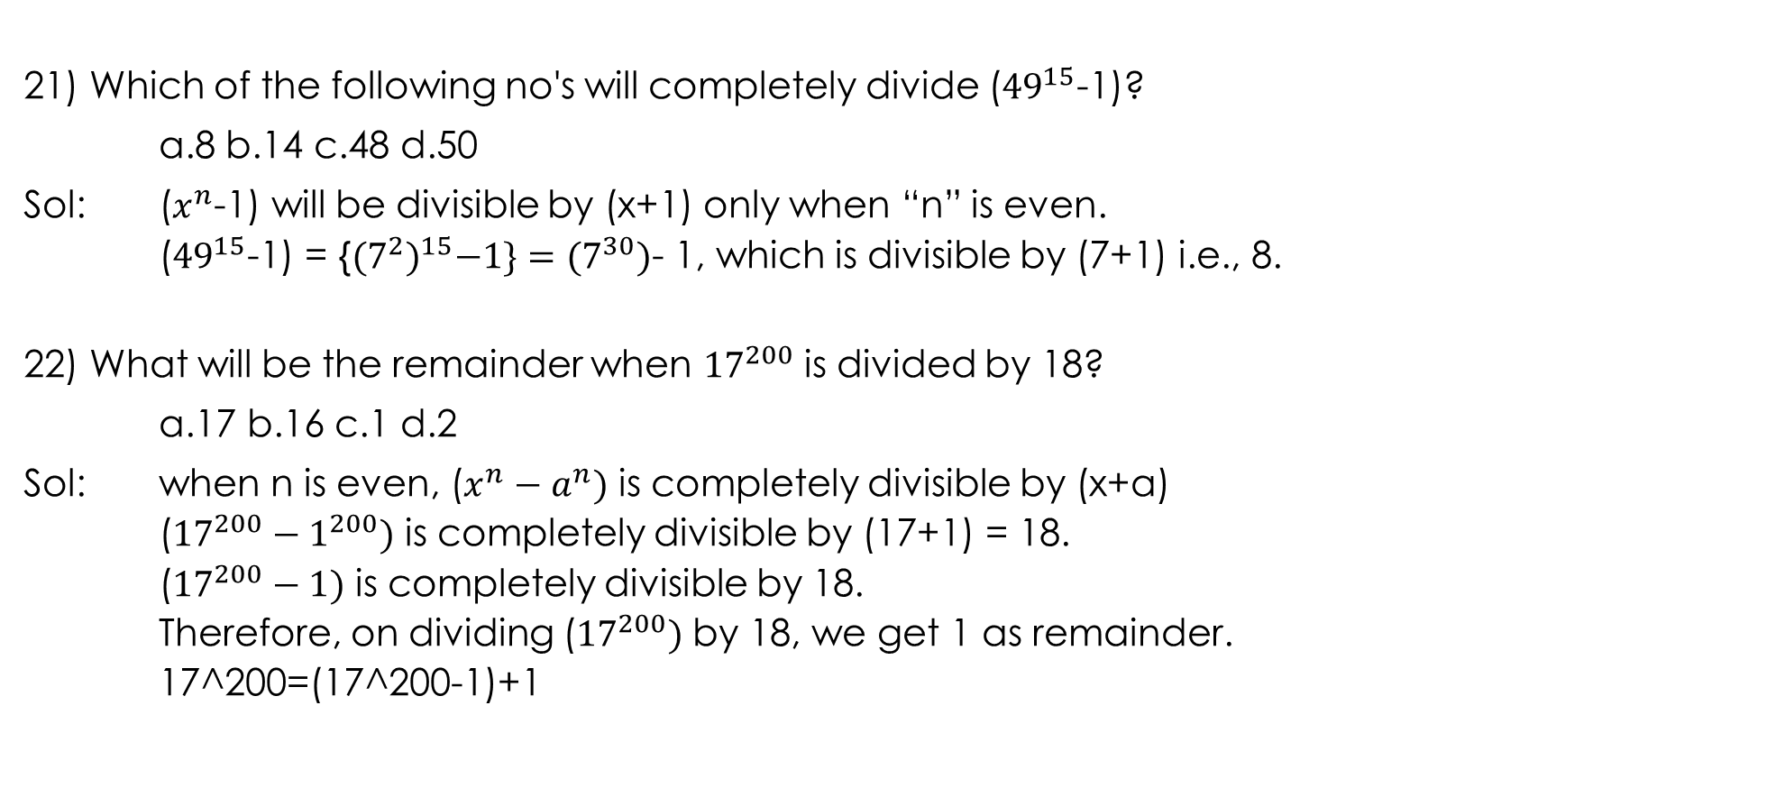
21) Which of the following no's will completely divide (${49}^{15}$-1)?
a.8 b.14 c.48 d.50
Sol: ($x^{n}$-1) will be divisible by (x+1) only when “n” is even.
(${49}^{15}$-1) = {${(7^{2})}^{15}−1\}=(7^{30})$- 1, which is divisible by (7+1) i.e., 8.
22) What will be the remainder when ${17}^{200}$ is divided by 18?
a.17 b.16 c.1 d.2
Sol: when n is even, ($x^{n}−a^{n})$ is completely divisible by (x+a)
(${17}^{200}−1^{200})$ is completely divisible by (17+1) = 18.
(${17}^{200}−1)$ is completely divisible by 18.
Therefore, on dividing (${17}^{200})$ by 18, we get 1 as remainder.
17^200=(17^200-1)+1

Slide 28
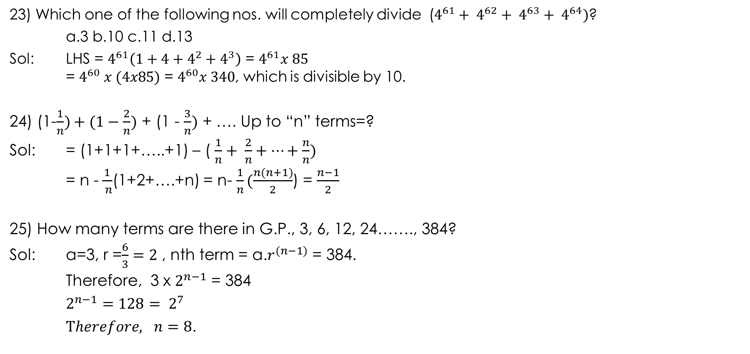
23) Which one of the following nos. will completely divide ($4^{61}+ 4^{62}+ 4^{63}+ 4^{64})$?
a.3 b.10 c.11 d.13
Sol: LHS = $4^{61}\left(1+4+4^{2}+4^{3}\right)$ = $4^{61}x 85$
= $4^{60} x (4x85)$ = $4^{60}x 340$, which is divisible by 10.
24) (1-$\frac{1}{n})+(1−\frac{2}{n})$ + (1 - $\frac{3}{n})$ + …. Up to “n” terms=?
Sol: = (1+1+1+…..+1) – ( $\frac{1}{n}+ \frac{2}{n}+…+\frac{n}{n})$
= n -$\frac{1}{ n}$(1+2+….+n) = n- $\frac{1}{n}(\frac{n(n+1)}{2}$) = $\frac{n−1}{2}$
25) How many terms are there in G.P., 3, 6, 12, 24……., 384?
Sol: a=3, r =$\frac{6}{3}=2$ , nth term = a.$r^{(n−1)}$ = 384.
Therefore, 3 x $2^{n−1}$ = 384
$$2^{n−1}=128= 2^{7}$$
$Therefore, n=8$.

Slide 29

26) ($2^{2}+4^{2}+ 6^{2}+…+ {20}^{2}$) = ?
a.770 b.1155 c.1540 d.385 x 385
Sol: LHS = (${\left(1x2\right)}^{2}+({2x2)}^{2}+ {\left(2x3\right)}^{2}+…+{\left(2x10\right)}^{2}$
= $2^{2}\left[1^{2}+2^{2}+3^{2}+…+{10}^{2}\right]$
= $2^{2}[\frac{10(10+1)(20+1)}{6}]$ = 1540.
27) (${11}^{2}+{12}^{2}+ {13}^{2}+…+ {20}^{2}$) = ?
Sol: $\left[1^{2}+2^{2}+3^{2}+…+{20}^{2}\right]$ - $\left[1^{2}+2^{2}+3^{2}+…+{10}^{2}\right]$
= $\frac{20(21)(41)}{6}$ - $\frac{10x11x21}{6}$
= 2870- 385
= 2485

Slide 30
H.C.F. & L.C.M. of NUMBERS
IMPORTANT FACTS AND FORMULAE
Factors And Multipliers:
If a number “a” divides another numbers “b” exactly, we say that “a” is a factor of “b”. In this case, “b” is called a multiple of “a”.
Ex: 4/2--------[Divisor × Quotient]+ [Reminder] = Dividend
Dividend= 4
Divisor= 2
Quotient = 2
Reminder= 0
Here 2 is a factor of 4 and 4 is a multiple of 2.

Slide 31
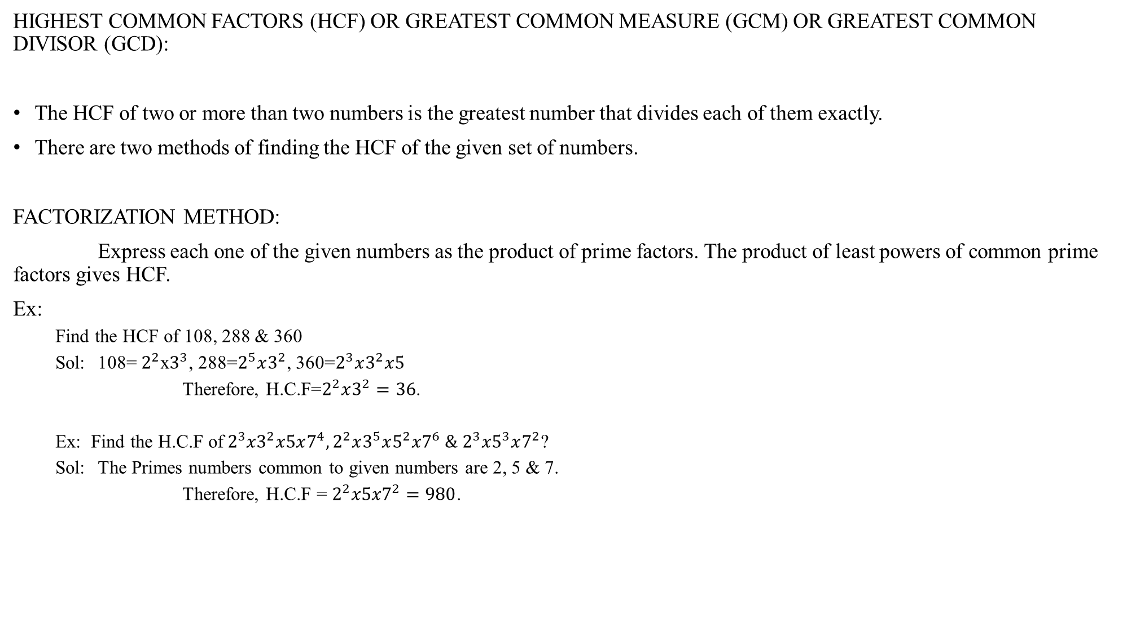
HIGHEST COMMON FACTORS (HCF) OR GREATEST COMMON MEASURE (GCM) OR GREATEST COMMON DIVISOR (GCD):
The HCF of two or more than two numbers is the greatest number that divides each of them exactly.
There are two methods of finding the HCF of the given set of numbers.
FACTORIZATION METHOD:
Express each one of the given numbers as the product of prime factors. The product of least powers of common prime factors gives HCF.
Ex:
Find the HCF of 108, 288 & 360
Sol: 108= $2^{2}$x$3^{3}$, 288=$2^{5}x3^{2}$, 360=$2^{3}x3^{2}x5$
Therefore, H.C.F=$2^{2}x3^{2}=36$.
Ex: Find the H.C.F of${ 2}^{3}{x3}^{2}x5x7^{4}, 2^{2}x3^{5}x5^{2}x7^{6} \& 2^{3}x5^{3}x7^{2}$?
Sol: The Primes numbers common to given numbers are 2, 5 & 7.
Therefore, H.C.F = $2^{2}x5{x7}^{2}=980$.

Slide 32
DIVISION METHOD:
Suppose we have to find the HCF of two given numbers. Divide the larger number by the smaller one. Now, divide the divisor by the remainder. Repeat the process of dividing the preceding number by the remainder last obtained till zero is obtained as remainder. The last divisor is the required HCF.
Ex:
Find the HCF of 513 & 81.
Sol: Therefore, HCF of given number = 27(last divisor)
FINDING THE H.C.F. OF MORE THAN TWO NUMBERS:
Suppose we have to find the HCF of three numbers. Then, HCF of [(HCF of any two numbers) & (the third number)] gives the HCF of three given numbers.
Similarly the HCF of more than three numbers may be obtained.
Ex:
Find the HCF of 513, 1134, 1215.
Sol: Therefore HCF of the given number is 27

Slide 33
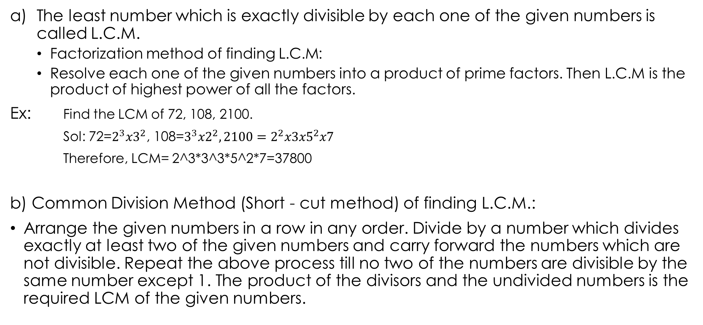
LEAST COMMON MULTIPLE (L.C.M)
The least number which is exactly divisible by each one of the given numbers is called L.C.M.
Factorization method of finding L.C.M:
Resolve each one of the given numbers into a product of prime factors. Then L.C.M is the product of highest power of all the factors.
Ex: Find the LCM of 72, 108, 2100.
Sol: 72=$2^{3}x3^{2}$, 108=$3^{3}x2^{2}, 2100=2^{2}x3{x5}^{2}x7$
Therefore, LCM= 2^3*3^3*5^2*7=37800
b) Common Division Method (Short - cut method) of finding L.C.M.:
Arrange the given numbers in a row in any order. Divide by a number which divides exactly at least two of the given numbers and carry forward the numbers which are not divisible. Repeat the above process till no two of the numbers are divisible by the same number except 1. The product of the divisors and the undivided numbers is the required LCM of the given numbers.

Slide 34
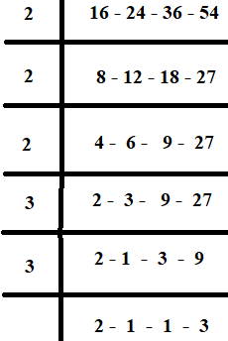

Find the LCM of 16, 24, 36 & 54.
Sol:
Therefore, L.C.M = 2x2x2x3x3x2x3= 432.
2) Find the LCM of $2^{2}x3^{3}x5x7^{2}, 2^{3}{x3}^{2}x5^{2}x7^{4} \& 2x3x5^{3}x7x11?$
Sol: LCM= Product of highest powers of 2, 3, 5, 7 and 11 = 2^3$x3^{3}x5^{3}x7^{4}x11$

Slide 35
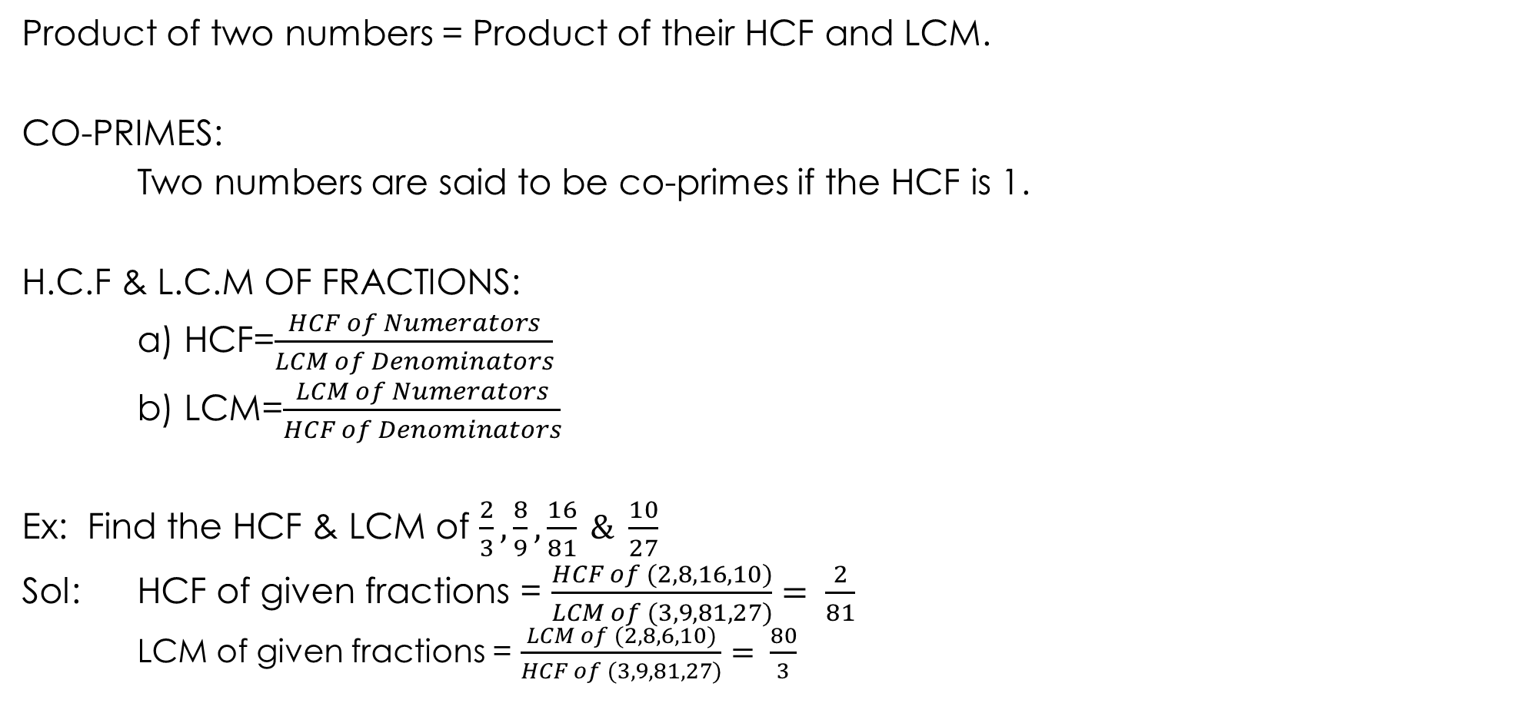
Product of two numbers = Product of their HCF and LCM.
CO-PRIMES:
Two numbers are said to be co-primes if the HCF is 1.
H.C.F & L.C.M OF FRACTIONS:
a) HCF=$\frac{HCF of Numerators}{LCM of Denominators}$
b) LCM=$\frac{LCM of Numerators}{HCF of Denominators}$
Ex: Find the HCF & LCM of $\frac{2}{3}, \frac{8}{9}, \frac{16}{81} \& \frac{10}{27}$
Sol: HCF of given fractions = $\frac{HCF of (2, 8, 16, 10)}{LCM of (3, 9, 81, 27)}= \frac{2}{81}$
LCM of given fractions = $\frac{LCM of (2, 8, 6, 10)}{HCF of (3, 9, 81, 27)}= \frac{80}{3}$

Slide 36
HCF and LCM of Decimal Fractions
In given numbers, make the same numbers of decimal places by annexing zeros in the same numbers, if necessary. considering these numbers without decimal point, find HCF or LCM as the case may be. Now, in the result, mark off as many decimal places as are there in each of the given numbers.
Ex:
Find the HCF and LCM of 0.63, 1.05, and 2.1
Sol: Making the same numbers of decimal places, the given numbers are: 0.63, 1.05 & 2.10
Without decimal places, these numbers are 63, 105 & 210
Now HCF of 63, 105 & 210 is: 21
Therefore, HCF of 0.63, 1.05 & 2.1 is: 0.21.
LCM of 63, 105 & 210 is: 630
Therefore LCM of 0.63, 1.05 & 2.1 is: 6.30

Slide 37
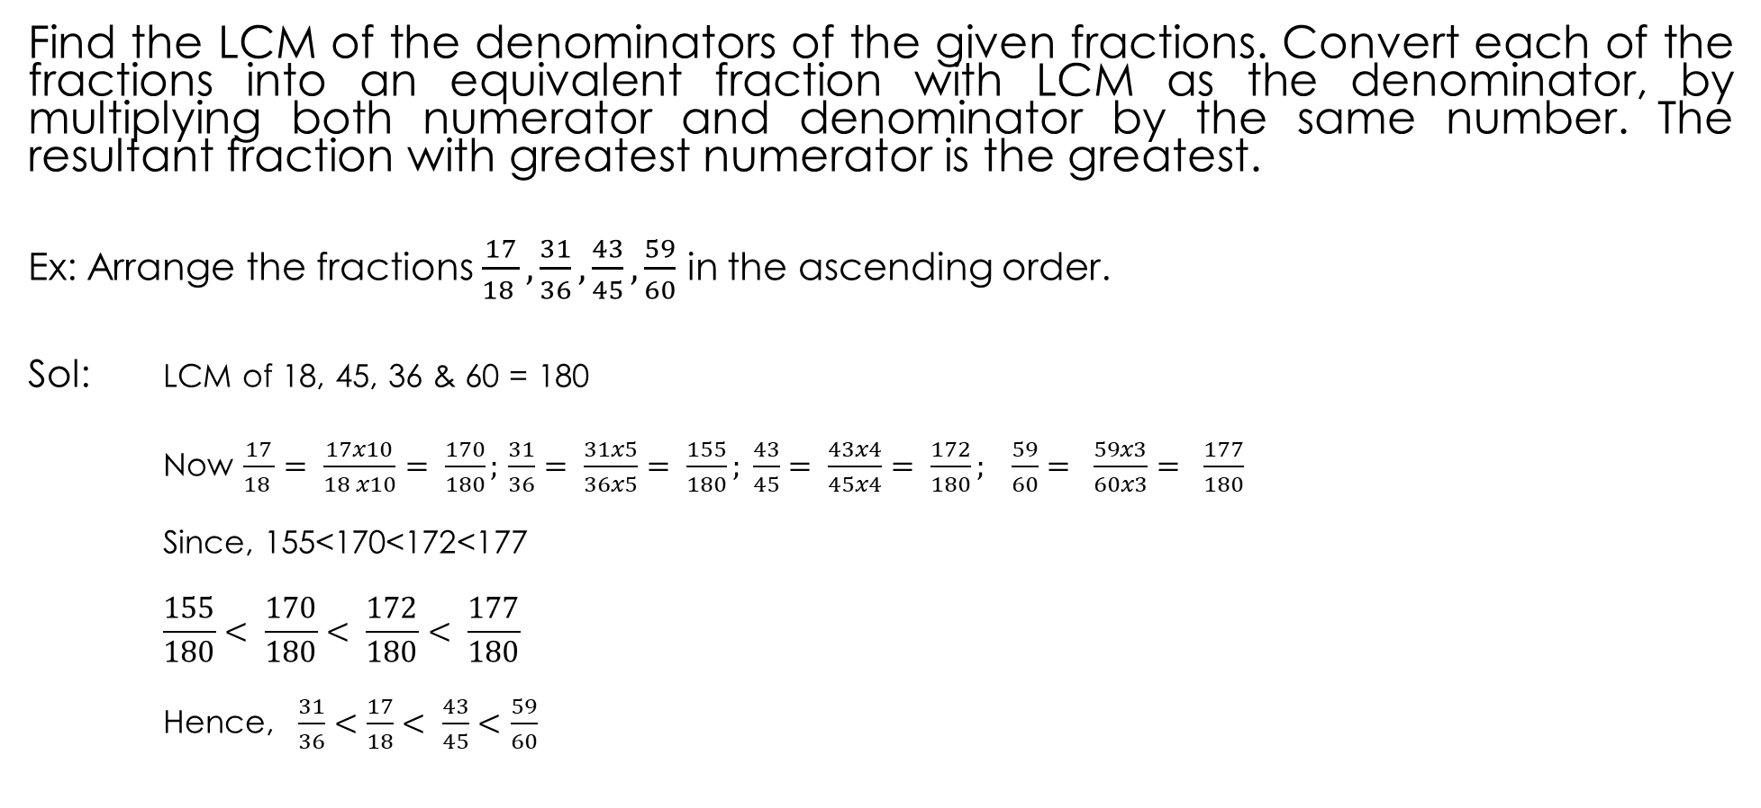
Comparison of Fractions
Find the LCM of the denominators of the given fractions. Convert each of the fractions into an equivalent fraction with LCM as the denominator, by multiplying both numerator and denominator by the same number. The resultant fraction with greatest numerator is the greatest.
Ex: Arrange the fractions $\frac{17}{18 }, \frac{31}{36}, \frac{43}{45}, \frac{59}{60}$ in the ascending order.
Sol: LCM of 18, 45, 36 & 60 = 180
Now $\frac{17}{18 }= \frac{17x10}{18 x10}= \frac{170}{180};\frac{31}{36}= \frac{31x5}{36x5}= \frac{155}{180}; \frac{43}{45}= \frac{43x4}{45x4}= \frac{172}{180}; \frac{59}{60}= \frac{59x3}{60x3}= \frac{177}{180}$
Since, 155<170<172<177
$$\frac{155}{180}< \frac{170}{180}< \frac{172}{180}< \frac{177}{180}$$
Hence, $\frac{31}{36}<\frac{17}{18}< \frac{43}{45}<\frac{59}{60}$

Slide 38
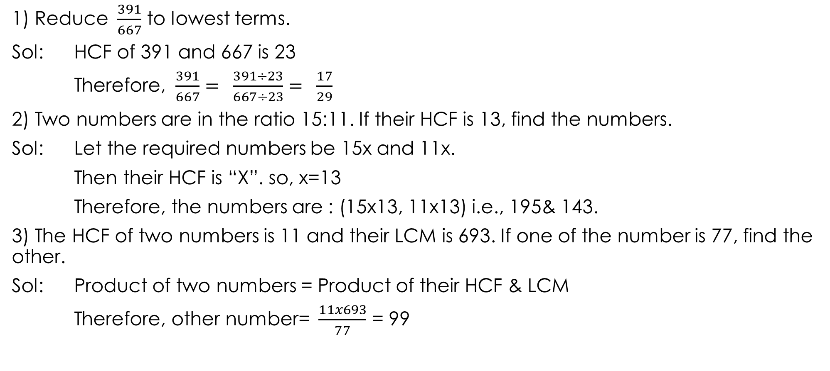
PROBLEMS
1) Reduce $\frac{391}{667}$ to lowest terms.
Sol: HCF of 391 and 667 is 23
Therefore, $\frac{391}{667}= \frac{391÷23}{667÷23}= \frac{17}{29}$
2) Two numbers are in the ratio 15:11. If their HCF is 13, find the numbers.
Sol: Let the required numbers be 15x and 11x.
Then their HCF is “X”. so, x=13
Therefore, the numbers are : (15x13, 11x13) i.e., 195& 143.
3) The HCF of two numbers is 11 and their LCM is 693. If one of the number is 77, find the other.
Sol: Product of two numbers = Product of their HCF & LCM
Therefore, other number= $\frac{11x693}{77}$ = 99

Slide 39
4) Find the greatest possible length which can be used to measure exactly the lengths 4m95cm, 9m & 16m65cm
Sol: Required length = HCF of (495cm, 900cm & 1665cm)
= HCF of (495, 900 & 1665)
= 45cm.
5) Find the greatest number which on dividing 1657 and 2037 leaves remainder 6& 5 respectively.
Sol: Required Number = HCF of (1657-6) & (2037-5)
= HCF of 1651 & 2032; so, Ans. : 127
6) Find the largest number which divides 62, 132 and 237 leaves the same remainder in each case.
Sol: Required number= HCF of (132-62), (237-132) & (237-62)
=HCF of (70, 105 & 175) = 35.

Slide 40
7) Find the least number which when divided by 6, 7, 8, 9 & 12 leaves the same remainder 1 in each case.
Sol: Required number= (LCM of 6, 7, 8, 9, 12) +1
Therefore LCM of (6, 7, 8, 9, 12) = 504
Therefore, required number = 504+1 = 505.
8) Find the largest number of four digits exactly divisible by 12, 15, 18 & 27.
The largest four digit number is 9999.
Sol: The req. no. must be divisible by LCM of 12, 15, 18 & 27 i.e, 540.
On dividing 9999 by 540, we get 279 as remainder.
Therefore, required number = (9999-279) = 9720.

Slide 41
9) Find the smallest number of five digits exactly divisible by 16, 24, 36 & 54.
Sol: smallest number of five digits is 10000
Required number must be divisible by LCM of given nos. i.e. 432.
On dividing 10000 by 432, we get 64 as remainder.
Required number = 10000+ (432-64) = 10368.
10) Find the least number which when divided by 20, 25, 35 & 40 leaves remainders 14, 19, 29 & 34 respectively.
Sol: Here (20-14) =6, (25-19) = 6, (35-29) = 6, (40-34) = 6.
Required Number= (LCM of 20, 25, 35, 40)-6 = 1394.

Slide 42
11) Find the least number which when divided by 5, 6, 7 & 8 leaves a remainder 3 but when divided by 9 leaves no remainder.
Sol: LCM of 5, 6, 7 and 8 = 840.
Req no. is of the form: 840k+3
Least value of k for which (840k+3) is divisible by 9 is k=2.
Therefore, required number = (840x2+3) = 1683.
12) The traffic lights at three different road crossing change after every 48sec, 72sec & 108sec respectively. If they all change simultaneously at 8:20:00hrs, then at which time will they again change simultaneously?
Sol: Interval of change = (LCM of 48, 72, 108)sec = 432sec.
So, lights will again change simultaneously after every 432sec. i.e., 7 min12sec.
Hence next simultaneous change will take place at 8:27:12hrs.

Slide 43
13) The sum of two nos. is 216 & their HCF is 27. The nos. are______
a.27,189 b.81,189 c.108.108 d.54,162.
Sol: Let the req. nos. be: 27a & 27b, then 27a+27b=216
a+b=8
Now, co-primes with 8 are: (1,7), (5,3)
Therefore, req. nos. are: (27x1, 27x7), (27x3, 27x5)
i.e, (27,189), (81,135)
14) The sum of two nos. is 528 and their HCF is 33. The number of pairs of nos. satisfying the above conditions is______
a) 4 b) 6 c) 8 d) 12
Sol: same as above, will get 4 pairs.
15) The LCM of two nos. is 48. The nos. are in the ratio 2:3, the sum of the nos. is____
a. 28 b.32 c.40 d.64
Sol: Let the nos. be 2x and 3x then their LCM = 6x.
So, 6x=48
X=8.
The nos. are 16, 24; sum is 40.

Slide 44
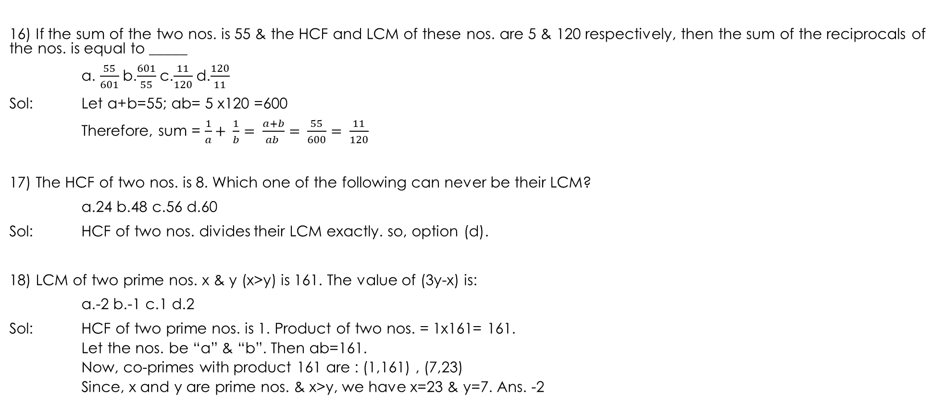
16) If the sum of the two nos. is 55 & the HCF and LCM of these nos. are 5 & 120 respectively, then the sum of the reciprocals of the nos. is equal to _____
a. $\frac{55}{601}$b.$\frac{601}{55}$c.$\frac{11}{120}$d.$\frac{120}{11}$
Sol: Let a+b=55; ab= 5 x120 =600
Therefore, sum = $\frac{1}{a}+ \frac{1}{b}= \frac{a+b}{ab }= \frac{55}{600}= \frac{11}{120}$
17) The HCF of two nos. is 8. Which one of the following can never be their LCM?
a.24 b.48 c.56 d.60
Sol: HCF of two nos. divides their LCM exactly. so, option (d).
18) LCM of two prime nos. x & y (x>y) is 161. The value of (3y-x) is:
a.-2 b.-1 c.1 d.2
Sol: HCF of two prime nos. is 1. Product of two nos. = 1x161= 161.
Let the nos. be “a” & “b”. Then ab=161.
Now, co-primes with product 161 are : (1,161) , (7,23)
Since, x and y are prime nos. & x>y, we have x=23 & y=7. Ans. -2

Slide 45
19) The maximum no. of students among them 1001 pens and 910 pencils can be distributed in such a way that each student gets the same number of pens & the same number of pencils are:
a.91 b.910 c.1001 d.1911
Sol: Req.no of students = HCF of (1001 and 910) = 91
20) The smallest number which when diminished by 7, is divisible by 12, 16, 18, 21 & 28 is:
a.1008 b.1015 c.1022 d.1032
Sol: Req.no.: =(LCM of 12, 16, 18, 21, 28 ) + 7 = 1008+7 = 1015.
21)The least no. which when increased by 5 is divisible by each one of 24, 32, 36 & 54 is:
a.427 b.859 c.869 d.4320
Sol: Req.no = (LCM of 24, 32, 36, 54)-5 = 864-5 = 859.

Slide 46
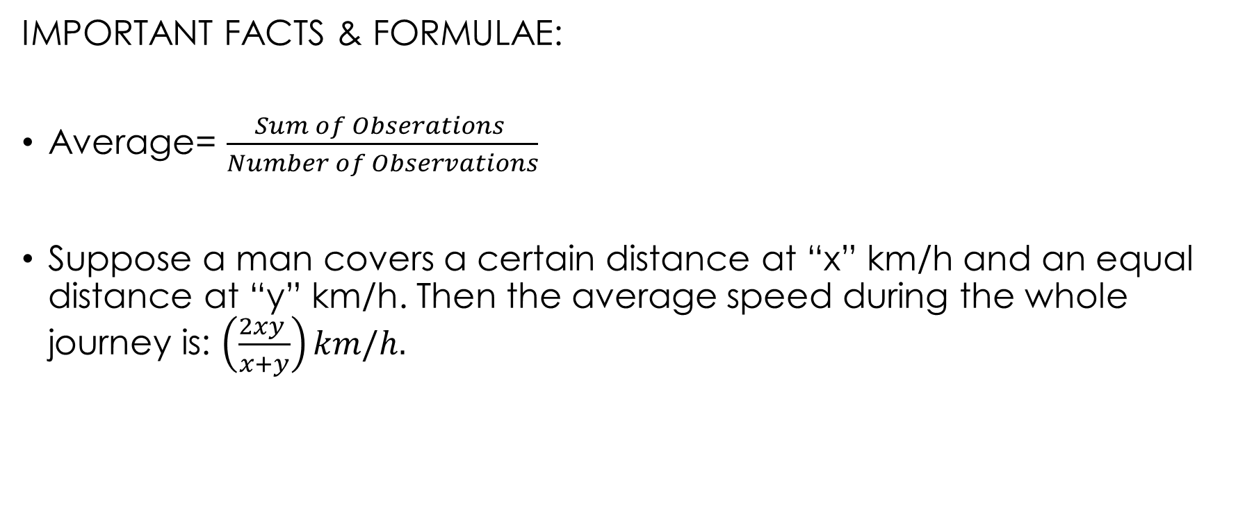
AVERAGE
IMPORTANT FACTS & FORMULAE:
Average= $\frac{Sum of Obserations }{Number of Observations}$
Suppose a man covers a certain distance at “x” km/h and an equal distance at “y” km/h. Then the average speed during the whole journey is: $\left(\frac{2xy }{x+y}\right)km/h.$

Slide 47
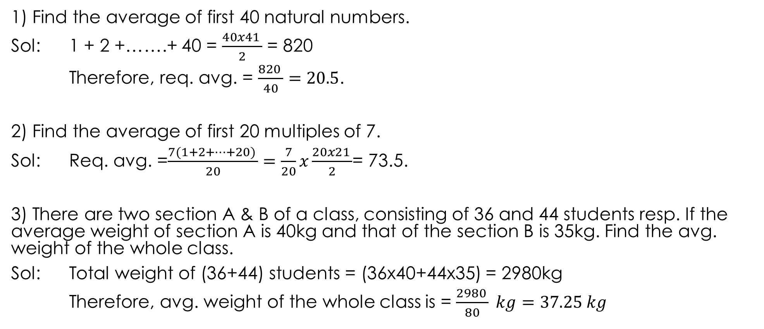
PROBLEMS
1) Find the average of first 40 natural numbers.
Sol: 1 + 2 +…….+ 40 = $\frac{40x41 }{2}$ = 820
Therefore, req. avg. = $\frac{820 }{40}=20.5$.
2) Find the average of first 20 multiples of 7.
Sol: Req. avg. =$\frac{7(1+2+…+20) }{20}=\frac{7}{20}x\frac{20x21 }{2}$= 73.5.
3) There are two section A & B of a class, consisting of 36 and 44 students resp. If the average weight of section A is 40kg and that of the section B is 35kg. Find the avg. weight of the whole class.
Sol: Total weight of (36+44) students = (36x40+44x35) = 2980kg
Therefore, avg. weight of the whole class is = $\frac{2980 }{80} kg=37.25 kg$

Slide 48
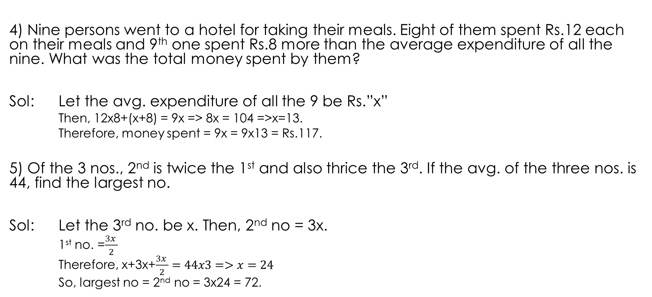
4) Nine persons went to a hotel for taking their meals. Eight of them spent Rs.12 each on their meals and 9th one spent Rs.8 more than the average expenditure of all the nine. What was the total money spent by them?
Sol: Let the avg. expenditure of all the 9 be Rs.”x”
Then, 12x8+(x+8) = 9x => 8x = 104 =>x=13.
Therefore, money spent = 9x = 9x13 = Rs.117.
5) Of the 3 nos., 2nd is twice the 1st and also thrice the 3rd. If the avg. of the three nos. is 44, find the largest no.
Sol: Let the 3rd no. be x. Then, 2nd no = 3x.
1st no. =$\frac{3x }{2}$
Therefore, x+3x+$\frac{3x }{2}=44x3=>x=24$
So, largest no = 2nd no = 3x24 = 72.

Slide 49
6) The avg. of 25 results is 18. The avg. of first twelve of them is 14 & that of last twelve is 17. Find the 13th result.
Sol: 13th result =(sum of 25 results) – (sum of 24 results)
=(18x25) –[12x14+12x17] = 78.
7) The avg. of 11 results is 60. If the avg. of first six results is 58 and that of the last 6 results is 63, find the 6th result.
Sol: 6th result = (58x6 + 63x6 – 60x11) =66
8) The avg. weight of A,B,C is 45kgs. If the avg. weight of A & B be 40kg & that of B & c be 43kg, find the weight of B.
Sol: Let A,B,C represents their individual weights. Then,
A+B+C = 45x3 = 135Kg
A+B = 40x2 = 80kg and B+C = 43x2 = 86kgs
Therefore, B = (A+B) + (B+C)- (A+B+C) = 31kgs.

Slide 50
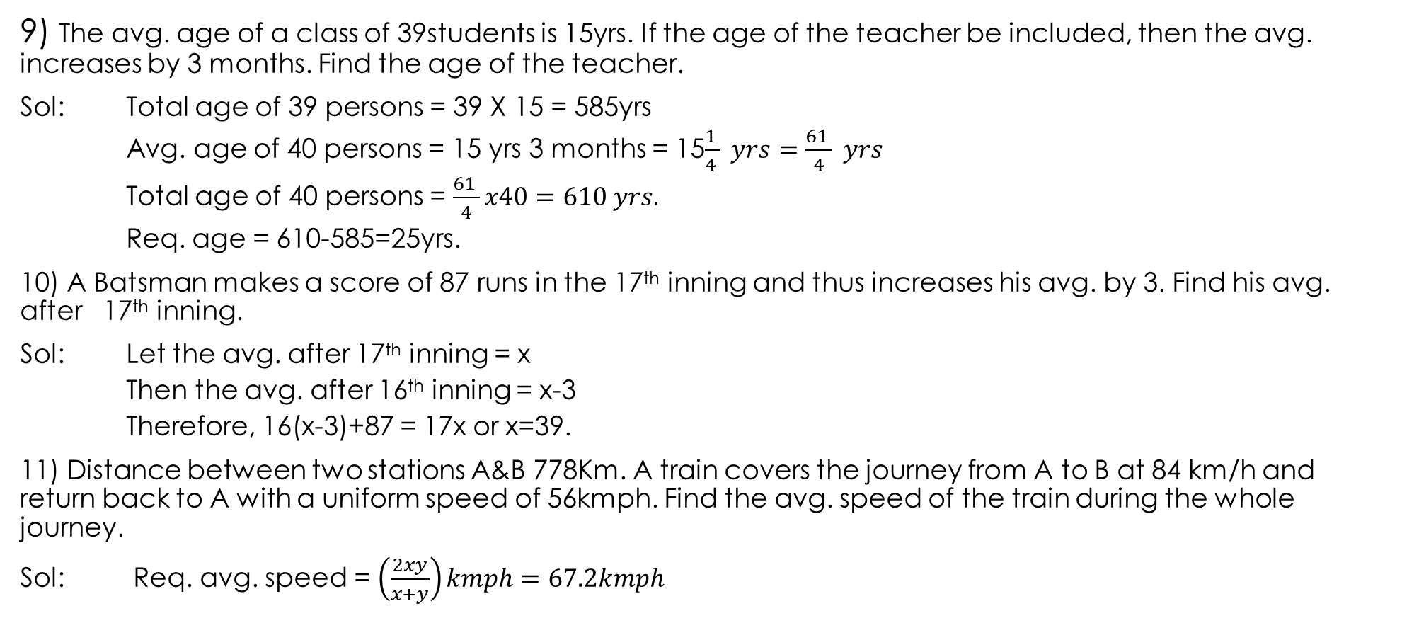
9) The avg. age of a class of 39students is 15yrs. If the age of the teacher be included, then the avg. increases by 3 months. Find the age of the teacher.
Sol: Total age of 39 persons = 39 X 15 = 585yrs
Avg. age of 40 persons = 15 yrs 3 months = 15$\frac{1 }{4 } yrs=\frac{61 }{4} yrs$
Total age of 40 persons = $\frac{61 }{4}x40=610 yrs.$
Req. age = 610-585=25yrs.
10) A Batsman makes a score of 87 runs in the 17th inning and thus increases his avg. by 3. Find his avg. after 17th inning.
Sol: Let the avg. after 17th inning = x
Then the avg. after 16th inning = x-3
Therefore, 16(x-3)+87 = 17x or x=39.
11) Distance between two stations A&B 778Km. A train covers the journey from A to B at 84 km/h and return back to A with a uniform speed of 56kmph. Find the avg. speed of the train during the whole journey.
Sol: Req. avg. speed = $\left(\frac{2xy}{x+y}\right)kmph=67.2kmph$

Slide 51
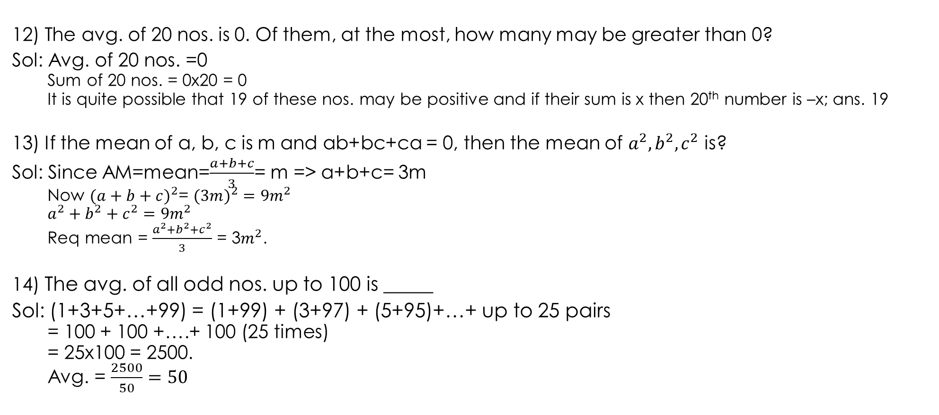
12) The avg. of 20 nos. is 0. Of them, at the most, how many may be greater than 0?
Sol: Avg. of 20 nos. =0
Sum of 20 nos. = 0x20 = 0
It is quite possible that 19 of these nos. may be positive and if their sum is x then 20th number is –x; ans. 19
13) If the mean of a, b, c is m and ab+bc+ca = 0, then the mean of $a^{2}, b^{2}, c^{2}$ is?
Sol: Since AM=mean=$\frac{a+b+c}{3}$= m =>a+b+c= 3m
Now ${(a+b+c)}^{2}$= $(3m)^{2}={9m}^{2}$
$$a^{2}+b^{2}+c^{2}=9m^{2}$$
Req mean = $\frac{a^{2}+b^{2}+c^{2}}{3}$ = 3$m^{2}$.
14) The avg. of all odd nos. up to 100 is _____
Sol: (1+3+5+…+99) = (1+99) + (3+97) + (5+95)+…+ up to 25 pairs
= 100 + 100 +….+ 100 (25 times)
= 25x100 = 2500.
Avg. = $\frac{2500}{50}=50$

Slide 52
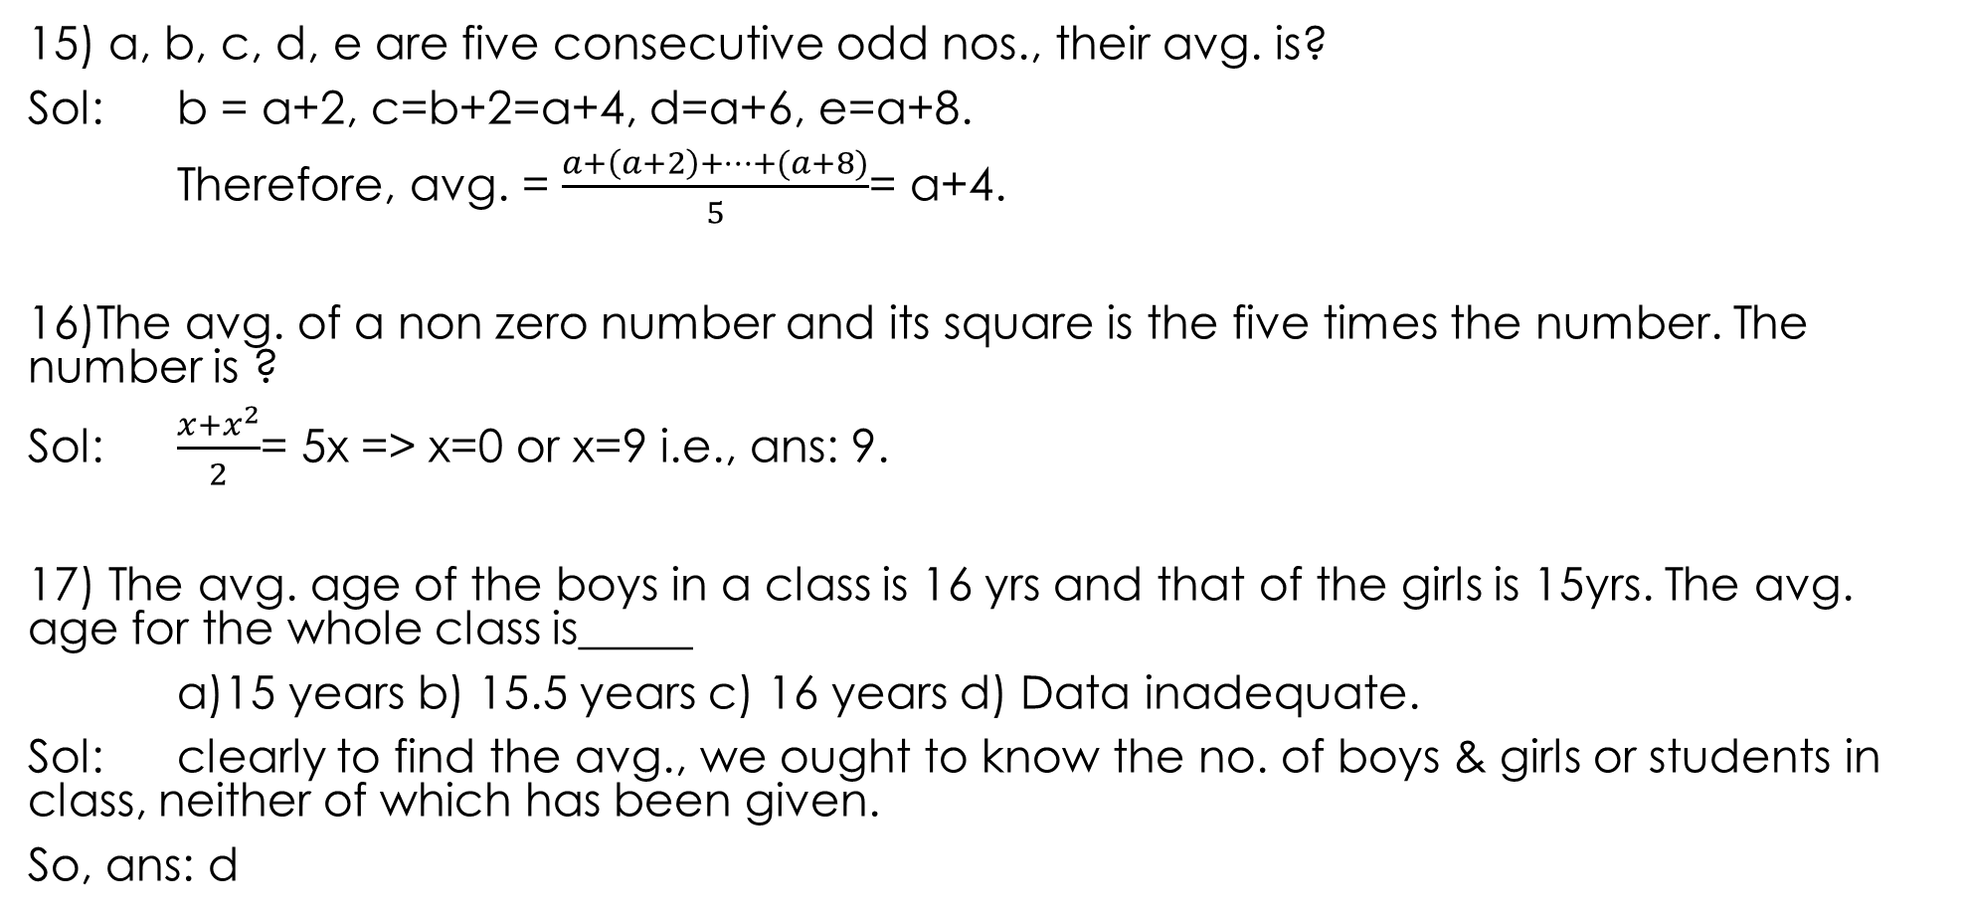
15) a, b, c, d, e are five consecutive odd nos., their avg. is?
Sol: b = a+2, c=b+2=a+4, d=a+6, e=a+8.
Therefore, avg. = $\frac{a+\left(a+2\right)+…+(a+8)}{5}$= a+4.
16)The avg. of a non zero number and its square is the five times the number. The number is ?
Sol: $\frac{x+x^{2}}{2}$= 5x => x=0 or x=9 i.e., ans: 9.
17) The avg. age of the boys in a class is 16 yrs and that of the girls is 15yrs. The avg. age for the whole class is_____
a)15 years b) 15.5 years c) 16 years d) Data inadequate.
Sol: clearly to find the avg., we ought to know the no. of boys & girls or students in class, neither of which has been given.
So, ans: d

Slide 53

19) The avg. of six nos. is “x” and the avg. of 3 of these is “y”. If the avg. of the remaining three is “z”, then
a) x=y+z b) 2x=y+z c) x=2y+2z d) none of them
Sol: Clearly x=$\frac{3y+3z}{6}$ or 2x=y+z

Slide 54
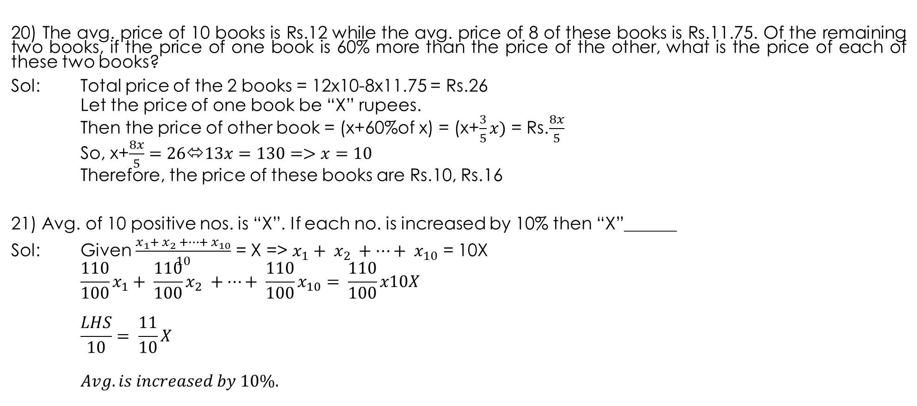
20) The avg. price of 10 books is Rs.12 while the avg. price of 8 of these books is Rs.11.75. Of the remaining two books, if the price of one book is 60% more than the price of the other, what is the price of each of these two books?
Sol: Total price of the 2 books = 12x10-8x11.75 = Rs.26
Let the price of one book be “X” rupees.
Then the price of other book = (x+60%of x) = (x+$\frac{3}{5}x)$ = Rs.$\frac{8x}{5}$
So, x+$\frac{8x}{5}=26⬄13x=130=>x=10$
Therefore, the price of these books are Rs.10, Rs.16
21) Avg. of 10 positive nos. is “X”. If each no. is increased by 10% then “X”______
Sol: Given $\frac{x_{1}+ x_{2} +…+ x_{10}}{10}$ = X =>$x_{1}+ x_{2} +…+ x_{10}$ = 10X
$$\frac{110}{100}x_{1}+ \frac{110}{100}x_{2} +…+ \frac{110}{100}x_{10}= \frac{110}{100}x10X$$
$$\frac{LHS}{10}= \frac{11}{10}X$$
$$Avg. is increased by 10\%.$$

Slide 55
22) The avg. temperature of the town in the 1st 4 days of a month was 58 degrees. The avg. for the 2nd, 3rd, 4th & 5th days was 60 degrees. If the temperature of the 1st & 5th days were in the ration 7:8, then what is the temp. on 5th day?
Sol: Sum of temperatures on 1^{s}t,…, 4th days = 58x4 = 232deg ----- [1]
Sum of temperatures on 2nd ,…, 5th days = 60x4 = 240deg ----- [2]
Now, [2]-[1] = Temp. on 5th day – Temp. on 1st day = 8deg.
Let the temperature on 1st and 5th days be 7x & 8x degrees respectively. Then,
8x – 7x = 8 => x=8.
Therefore, on 5th day temp.= 8x = 64 degrees.

Slide 56
23) The avg. weight of 3 men A, B & C is 84kgs. Another man D joins the group and the avg. now becomes 80kgs. If another man E, whose weight is 3kgs more than that of D, replaces A, then the avg. weight of B,C,D,E becomes 79 kgs. The weight of A is_____
Sol: Let A, B, C, D, E represent their respective weights. Then,
A+B+C = 84x3 = 252kgs----------[1]
A+B+C+D = 80x4 = 320kgs---------[2]
Therefore, D= [2]-[1]= 68 kgs
E = (68+3)kg = 71kgs
Now B+C+D+E = 79x4 = 316 kgs-----------[3]
Now [2]-[3] = 320-316 = 4 kgs
i.e., A-E = 4 => A=4+E
Therefore, A=75 kgs.

Slide 57
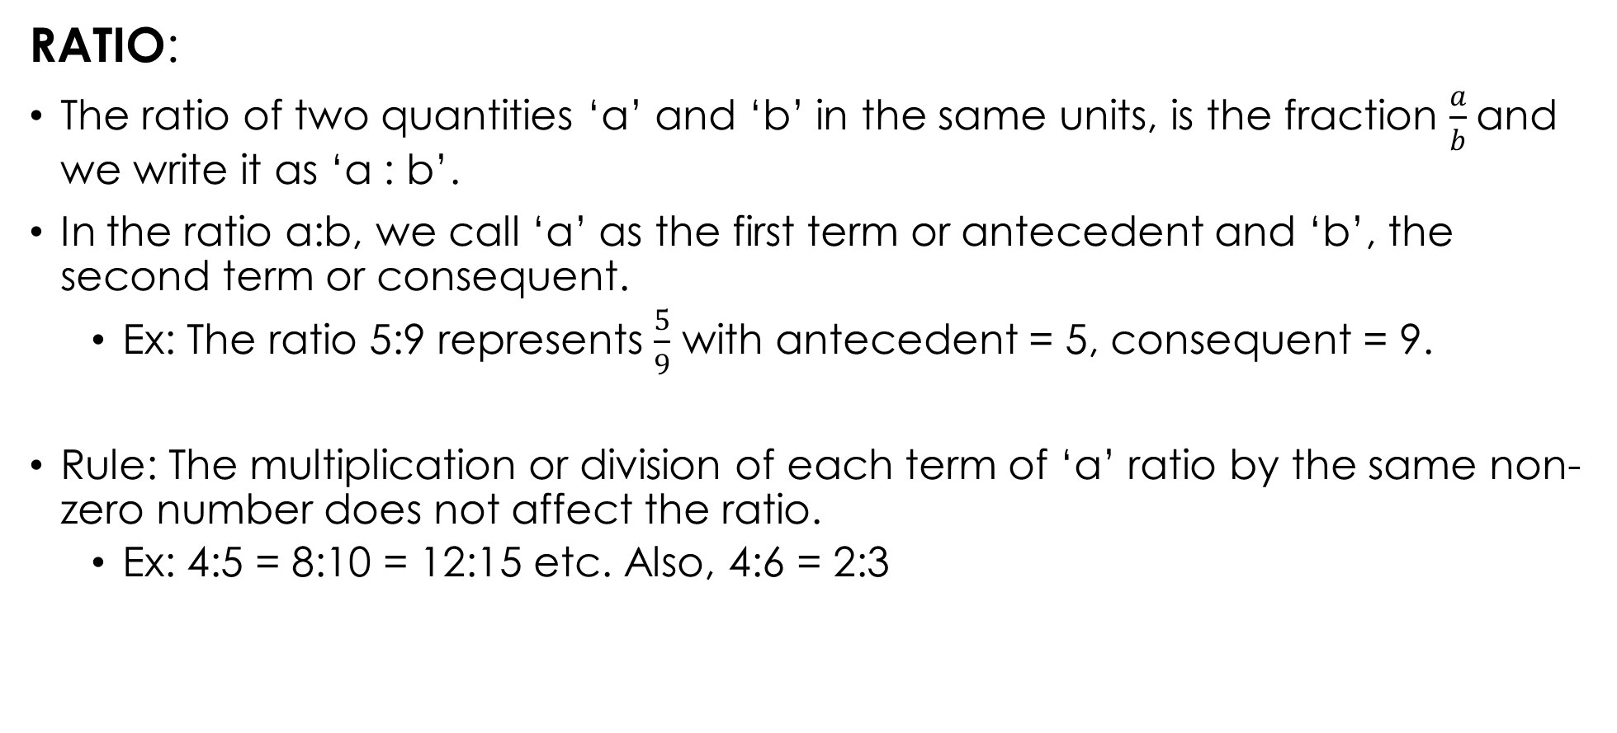
RATIO AND PROPORTION
RATIO:
The ratio of two quantities ‘a’ and ‘b’ in the same units, is the fraction $\frac{a}{b}$and we write it as ‘a : b’.
In the ratio a:b, we call ‘a’ as the first term or antecedent and ‘b’, the second term or consequent.
Ex: The ratio 5:9 represents $\frac{5}{9}$ with antecedent = 5, consequent = 9.
Rule: The multiplication or division of each term of ‘a’ ratio by the same non-zero number does not affect the ratio.
Ex: 4:5 = 8:10 = 12:15 etc. Also, 4:6 = 2:3

Slide 58
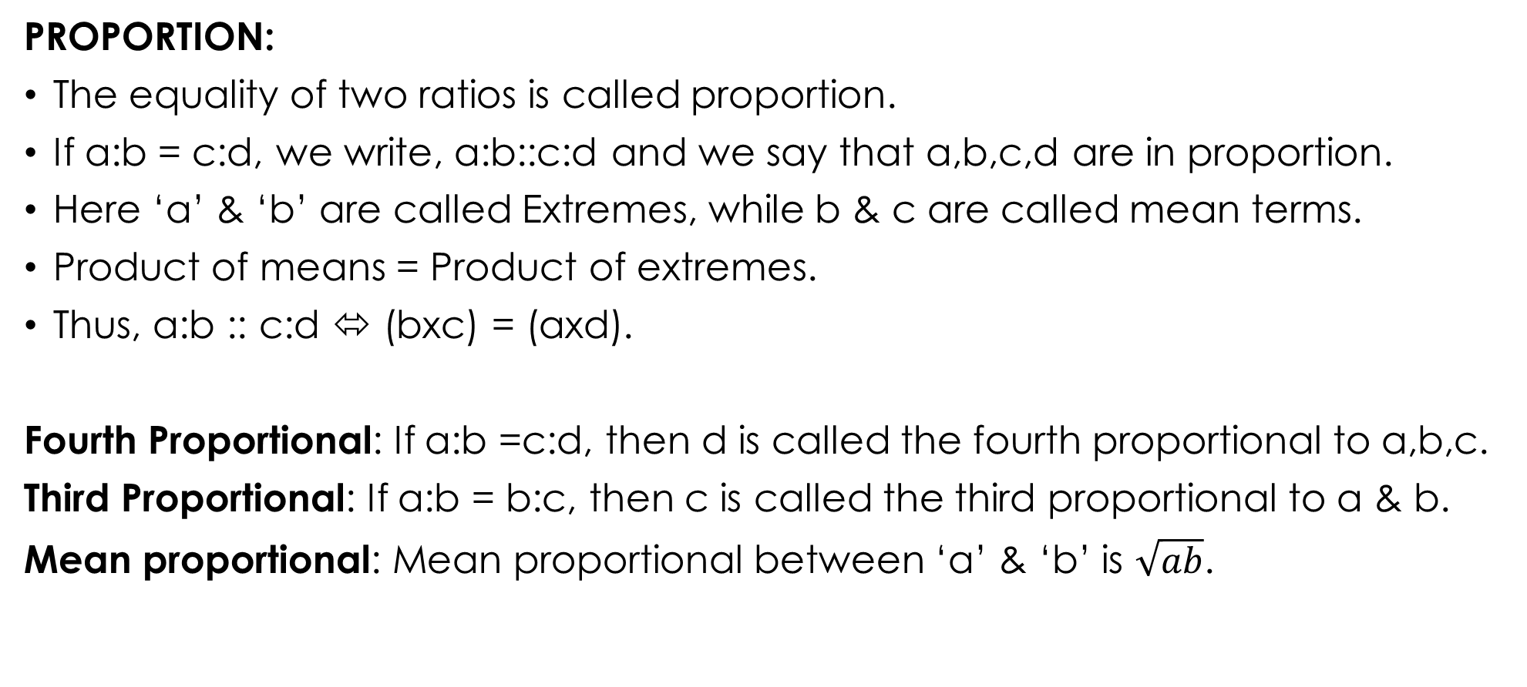
PROPORTION:
The equality of two ratios is called proportion.
If a:b = c:d, we write, a:b::c:d and we say that a,b,c,d are in proportion.
Here ‘a’ & ‘b’ are called Extremes, while b & c are called mean terms.
Product of means = Product of extremes.
Thus, a:b :: c:d ⬄ (bxc) = (axd).
Fourth Proportional: If a:b =c:d, then d is called the fourth proportional to a,b,c.
Third Proportional: If a:b = b:c, then c is called the third proportional to a & b.
Mean proportional: Mean proportional between ‘a’ & ‘b’ is $\sqrt{ab}$.

Slide 59

problems
1) If a : b = 5 : 9 & b : c = 4 : 7, find a : b : c?
Sol: a : b = 5 : 9 and b : c = 4 : 7 = $(4x\frac{9}{4}$) : $(7x\frac{9}{4}$) = 9 : $\frac{63}{4}$
a : b : c = 5 : 9 : $\frac{63}{4}$ = 20 : 36 : 63.
2) Find
The 4th proportional to 4, 9, 12
The 3rd proportional to 16 & 36,
The mean proportional between 0.08 & 0.18
Sol:
a. Let the 4th proportional to 4, 9, 12 be x.
Then, 4 : 9 : : 12 : x ⬄ 4 × x = 9 × 12 ⬄ x = $\frac{9 ×12}{4}=27.$
4th proportional to 4, 9, 12 is 27.
b. Let the 3rd proportional to 16 & 36 be x
Then, 16 : 36 : : 36 : x ⬄ 16 × x = 36 × 36 ⬄ x = $\frac{36 × 36}{16}$ = 81.
3rd proportional to 16 & 36 is 81.
c. Mean proportional between 0.08 and 0.18
$$\sqrt{0.08 ×0.18}= \sqrt{\frac{8}{100}×\frac{18}{100}}= \sqrt{\frac{144}{100×100} }= \frac{12}{100}=0.12.$$

Slide 60
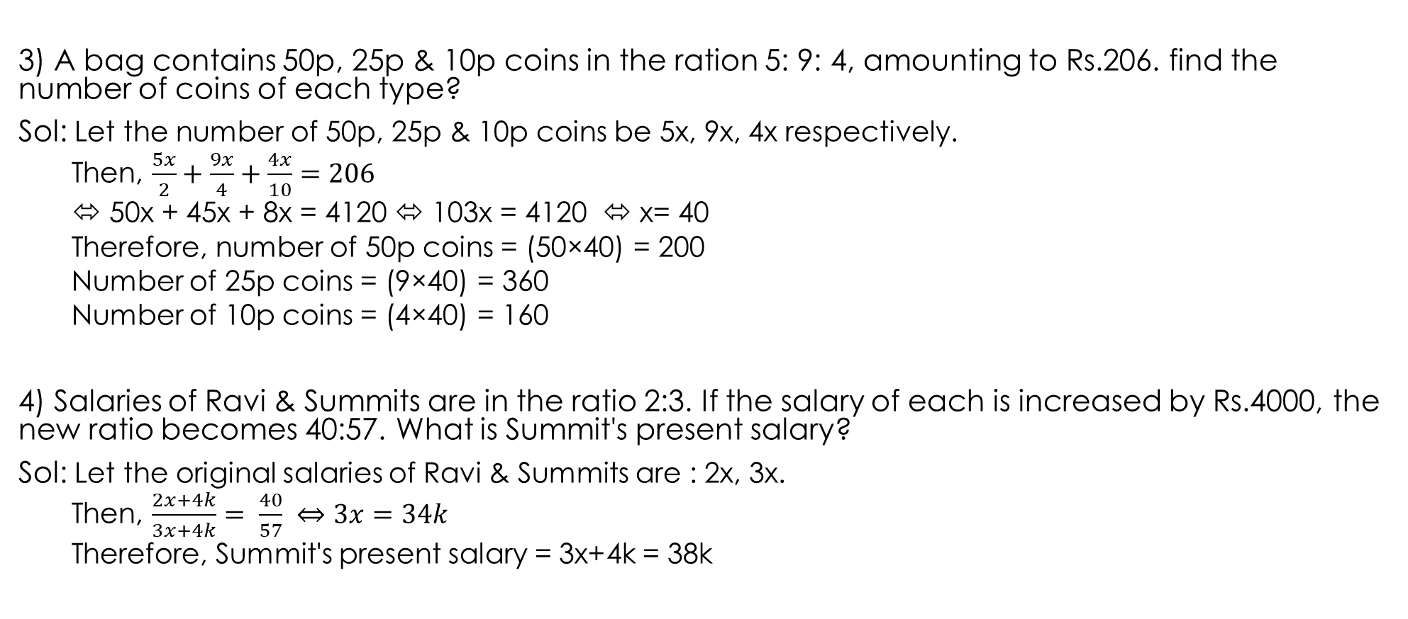
3) A bag contains 50p, 25p & 10p coins in the ration 5: 9: 4, amounting to Rs.206. find the number of coins of each type?
Sol: Let the number of 50p, 25p & 10p coins be 5x, 9x, 4x respectively.
Then, $\frac{5x}{2}+\frac{9x}{4}+\frac{4x}{10}=206$
⬄ 50x + 45x + 8x = 4120 ⬄ 103x = 4120 ⬄ x= 40
Therefore, number of 50p coins = (50×40) = 200
Number of 25p coins = (9×40) = 360
Number of 10p coins = (4×40) = 160
4) Salaries of Ravi & Summits are in the ratio 2:3. If the salary of each is increased by Rs.4000, the new ratio becomes 40:57. What is Summit's present salary?
Sol: Let the original salaries of Ravi & Summits are : 2x, 3x.
Then, $\frac{2x+4k}{3x+4k}= \frac{40}{57} ⇔3x=34k$
Therefore, Summit's present salary = 3x+4k = 38k

Slide 61
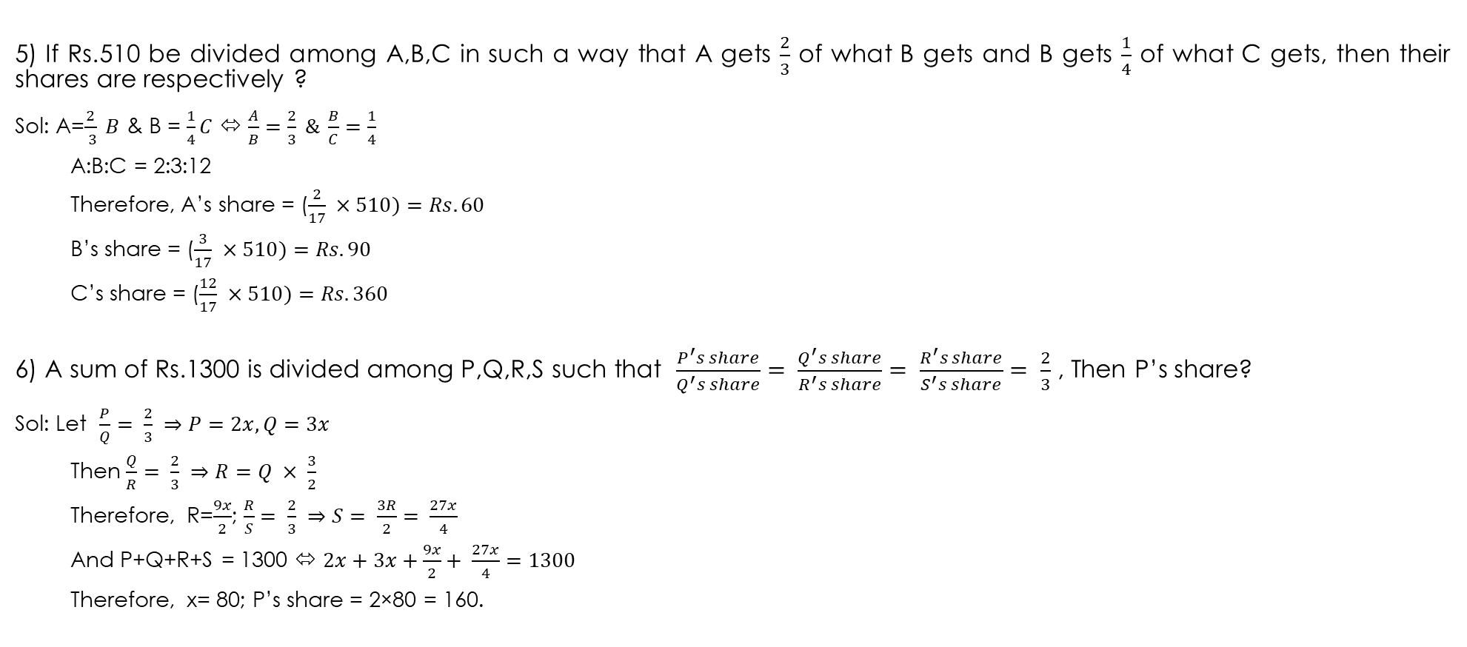
5) If Rs.510 be divided among A,B,C in such a way that A gets $\frac{2}{3}$ of what B gets and B gets $\frac{1}{4}$ of what C gets, then their shares are respectively ?
Sol: A=$\frac{2}{ 3} B$& B = $\frac{1}{4}C$⬄$\frac{A}{B}=\frac{2}{3} \& \frac{B}{C}=\frac{1}{4}$
A:B:C = 2:3:12
Therefore, A’s share = ($\frac{2}{17} ×510)=Rs.60$
B’s share = ($\frac{3}{17} ×510)=Rs.90$
C’s share = ($\frac{12}{17} ×510)=Rs.360$
6) A sum of Rs.1300 is divided among P,Q,R,S such that $\frac{P^{′}s share}{Q^{′}s share}= \frac{Q^{′}s share}{R^{′}s share}= \frac{R^{′}s share}{S^{′}s share}= \frac{2}{3}$ , Then P’s share?
Sol: Let $\frac{P}{Q}= \frac{2}{3} ⇒P=2x, Q=3x$
Then $\frac{Q}{R}= \frac{2}{3} ⇒R=Q × \frac{3}{2}$
Therefore, R=$\frac{9x}{2}$; $\frac{R}{S}= \frac{2}{3} ⇒S= \frac{3R}{2}= \frac{27x}{4}$
And P+Q+R+S = 1300 ⬄$2x+3x+\frac{9x}{2}+ \frac{27x}{4}=1300$
Therefore, x= 80; P’s share = 2×80 = 160.

Slide 62
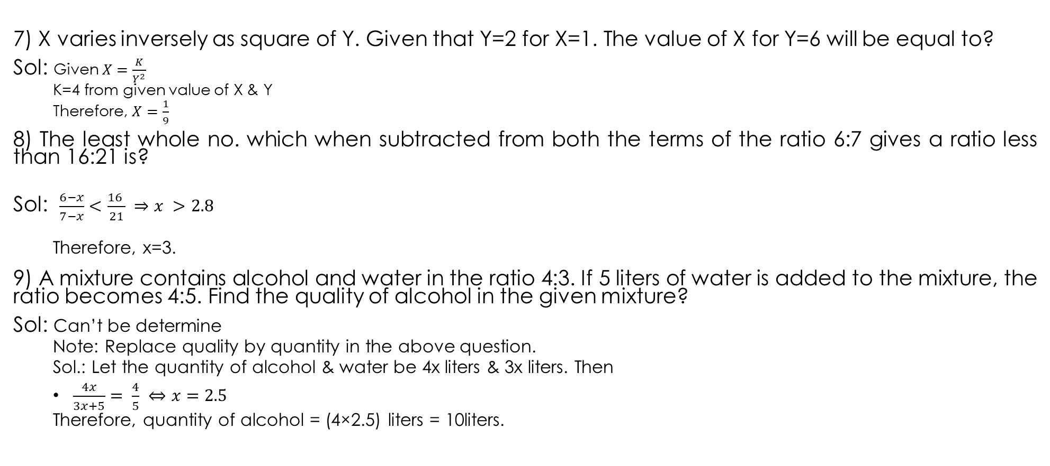
7) X varies inversely as square of Y. Given that Y=2 for X=1. The value of X for Y=6 will be equal to?
Sol: Given $X=\frac{K}{Y^{2}}$
K=4 from given value of X & Y
Therefore, $X=\frac{1}{9}$
8) The least whole no. which when subtracted from both the terms of the ratio 6:7 gives a ratio less than 16:21 is?
Sol: $\frac{6−x}{7−x}<\frac{16 }{21} ⇒x >2.8$
Therefore, x=3.
9) A mixture contains alcohol and water in the ratio 4:3. If 5 liters of water is added to the mixture, the ratio becomes 4:5. Find the quality of alcohol in the given mixture?
Sol: Can’t be determine
Note: Replace quality by quantity in the above question.
Sol.: Let the quantity of alcohol & water be 4x liters & 3x liters. Then
$\frac{4x}{3x+5}= \frac{4}{5} ⇔x=2.5$
Therefore, quantity of alcohol = (4×2.5) liters = 10liters.

Slide 63
10) A:B = 3:4 and B:C=8:9 then A:C is?
Sol: $\frac{A}{B}=\frac{3}{4},\frac{B}{C}=\frac{8}{9};\frac{A}{C}=\frac{A}{B}×\frac{B}{C}=\frac{3}{4}×\frac{8}{9}=\frac{2}{3}$
11) A:B=8:15, B:C=5:8, C:D=4:5 then A:D=?
Sol: $\frac{A}{D}=\frac{A}{B}×\frac{B}{C} ×\frac{C}{D}=4:15$
12) If A:B:C = 2:3:4 then $\frac{A}{B}:\frac{B}{C}:\frac{C}{A}$is equal to?
Sol: Let A=2x, B=3x, c=4x
Then $\frac{A}{B}=\frac{2}{3}, \frac{B}{C}=\frac{3}{4}, \frac{ C}{A}=\frac{2}{1}$
$\frac{A}{B}:\frac{B}{C}:\frac{ C}{A}=\frac{2}{3}:\frac{3}{4}:\frac{2}{1}=8:9:24$
13) If $A:B=\frac{1}{2}:\frac{3}{8}, B:C=\frac{1}{3}:\frac{5}{9} \& C:D=\frac{5}{6}:\frac{3}{4},$then the ratio A:B:C:D is?
Sol: A:B=4:3, B:C=3:5, C:D=10:9
Now: C:D = $5:\frac{9}{2}$ ; A:B:C:D =4:3:5:$\frac{9}{2}$
i.e., 8:6:10:9.

Slide 64

14) If 2A=3B=4C, then A:B:C=?
Sol: Let 2A=3B=4C=K, then
$A=\frac{K}{2}, B=\frac{K}{3}, C=\frac{K}{4}$
A:B:C = $\frac{K}{2}: \frac{K}{3}: \frac{K}{4}=6:4:3$
15) The ratio of $4^{3.5}:2^{5}$ is same as?
Sol: $\frac{4^{3.5}}{2^{5}}= \frac{{(2^{2})}^{3.5}}{2^{5}}=\frac{2^{7}}{2^{5}}=4$
Therefore, req. ratio is 4:1.
16) If (x:y) = 2:1 then ($x^{2}−y^{2}) :(x^{2}+y^{2})$ is?
Sol: $\frac{x}{y}=\frac{2}{1} ⇒ \frac{x^{2}}{y^{2}}=\frac{2^{2}}{1} ⇔ \frac{x^{2}+y^{2}}{x^{2}−y^{2}}=\frac{4+1}{4−1}\left(by c\&d rule \right) ⇔ \frac{x^{2}+y^{2}}{x^{2}−y^{2}}=\frac{5}{3};$
Req. ratio = 3:5.

Slide 65
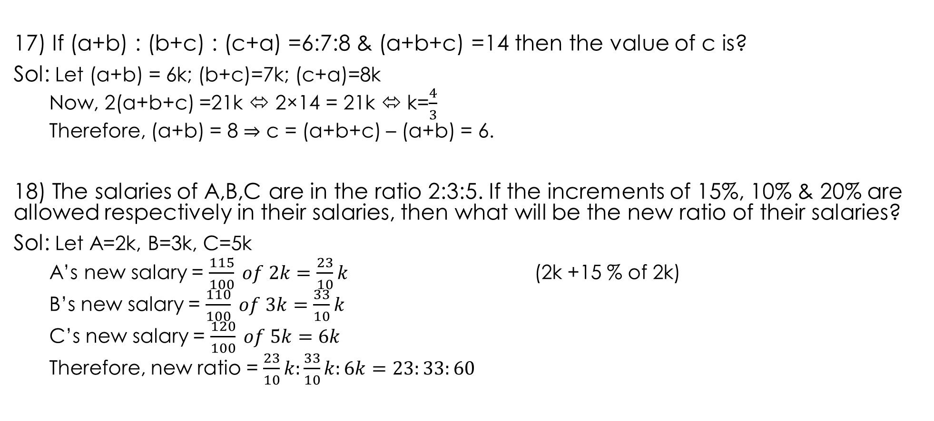
17) If (a+b) : (b+c) : (c+a) =6:7:8 & (a+b+c) =14 then the value of c is?
Sol: Let (a+b) = 6k; (b+c)=7k; (c+a)=8k
Now, 2(a+b+c) =21k ⬄ 2×14 = 21k ⬄ k=$\frac{4}{3}$
Therefore, (a+b) = 8 ⇒ c = (a+b+c) – (a+b) = 6.
18) The salaries of A,B,C are in the ratio 2:3:5. If the increments of 15%, 10% & 20% are allowed respectively in their salaries, then what will be the new ratio of their salaries?
Sol: Let A=2k, B=3k, C=5k
A’s new salary = $\frac{115}{100} of 2k=\frac{23}{10}k$ (2k +15 % of 2k)
B’s new salary = $\frac{110}{100} of 3k=\frac{33}{10}k$
C’s new salary = $\frac{120}{100} of 5k=6k$
Therefore, new ratio = $\frac{23}{10}k:\frac{33}{10}k:6k=23:33:60$

Slide 66
19) Two whole nos. whose sum is 72 cannot be in the ratio?
a. 5:7 b.3:5 c.4:5 d.3:4
Sol: The sum of the ratio terms must divide 72.
So, the ratio 3:4 cannot be.
20 )If a carton containing a dozen mirrors is dropped, which of the following cannot be the ratio of broken mirrors to unbroken mirrors?
a. 2:1 b. 3:1 c. 3:2 d. 7:5
Sol: For dividing 12 into whole numbers the sum of the ratio terms must be a factor of 12. So , they cannot be in the ratio 3:2.

Slide 67
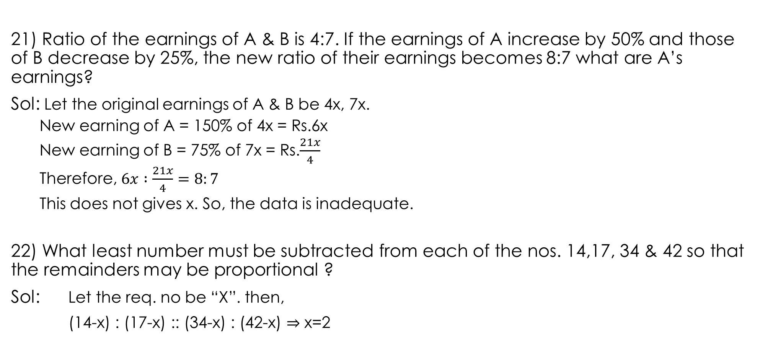
21) Ratio of the earnings of A & B is 4:7. If the earnings of A increase by 50% and those of B decrease by 25%, the new ratio of their earnings becomes 8:7 what are A’s earnings?
Sol: Let the original earnings of A & B be 4x, 7x.
New earning of A = 150% of 4x = Rs.6x
New earning of B = 75% of 7x = Rs.$\frac{21x}{4}$
Therefore, $6x :\frac{21x}{4}=8:7$
This does not gives x. So, the data is inadequate.
22) What least number must be subtracted from each of the nos. 14,17, 34 & 42 so that the remainders may be proportional ?
Sol: Let the req. no be “X”. then,
(14-x) : (17-x) :: (34-x) : (42-x) ⇒ x=2

Slide 68
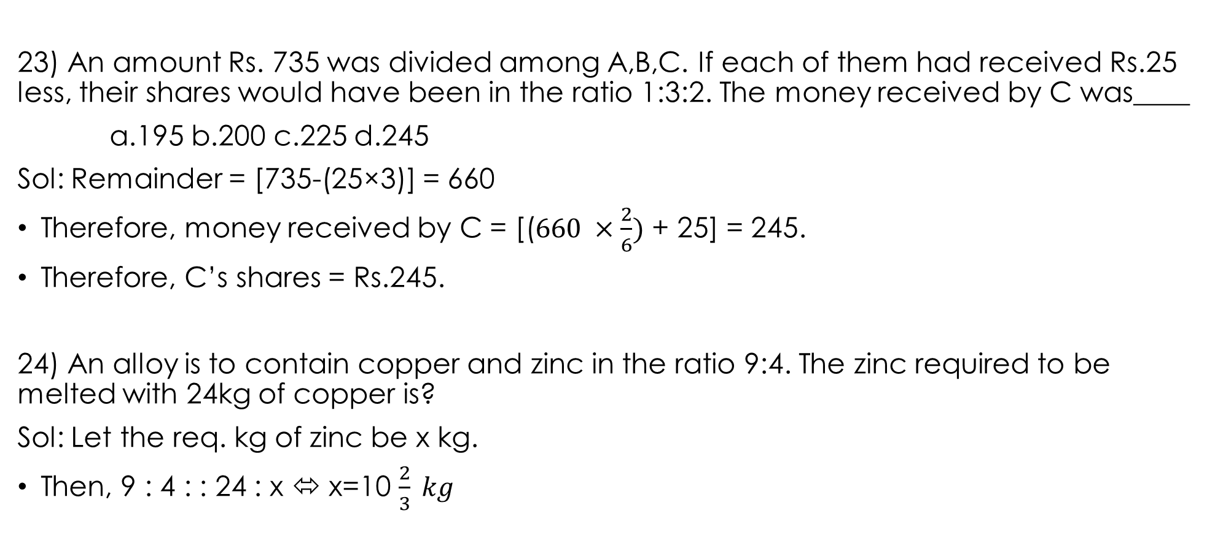
23) An amount Rs. 735 was divided among A,B,C. If each of them had received Rs.25 less, their shares would have been in the ratio 1:3:2. The money received by C was____
a.195 b.200 c.225 d.245
Sol: Remainder = [735-(25×3)] = 660
Therefore, money received by C = [($660 ×\frac{2}{6})$ + 25] = 245.
Therefore, C’s shares = Rs.245.
24) An alloy is to contain copper and zinc in the ratio 9:4. The zinc required to be melted with 24kg of copper is?
Sol: Let the req. kg of zinc be x kg.
Then, 9 : 4 : : 24 : x ⬄ x=10 $\frac{2}{3} kg$

Slide 69
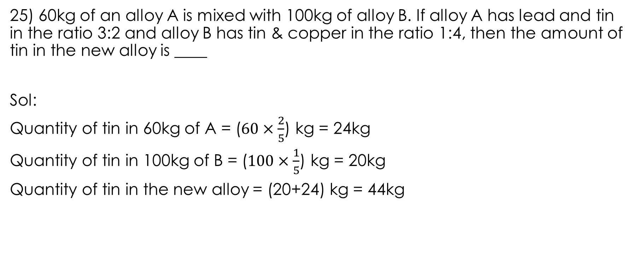
25) 60kg of an alloy A is mixed with 100kg of alloy B. If alloy A has lead and tin in the ratio 3:2 and alloy B has tin & copper in the ratio 1:4, then the amount of tin in the new alloy is ____
Sol:
Quantity of tin in 60kg of A = ($60×\frac{2}{5}$) kg = 24kg
Quantity of tin in 100kg of B = ($100×\frac{1}{5}$) kg = 20kg
Quantity of tin in the new alloy = (20+24) kg = 44kg

Slide 70
DATA SUFFICIENCY
Pattern: Q On Average Topic
Statements: 1 & 2
Options:
1 is sufficient but not 2 is sufficient.
2 is sufficient but not 1 is sufficient.
Either 1 is sufficient or 2 is sufficient.
Neither 1 nor 2 is sufficient.
Both 1 and 2 is sufficient.
Pattern-1: Q; statements 1 & 2.
Pattern-2: Q; statements 1, 2 & 3.
2 & 1 only
2 & 3 only
1 & 3 only
All three
None of these

Slide 71
Thank You

